Slide 1

Adobe Experience Manager Architecture
Objectives:
Describe the architecture of AEM
Understand Cloud Manager for AEM
Explain how AEM fits into the Adobe Experience Cloud

Slide 2


















Adobe Experience Manager drives Experiences
Source | Create
Ingest any number of content types: Creative Cloud, Stock, Brand Assets and more
Manage | Assemble
Easily store, find and compose varied experiences
Personalize | Deliver
Intelligent personalization and channel-agnostic content delivery
Dynamic Forms & Docs
Adobe Experience Manager
Connected Screens
Social Media
Web & Mobile Site
Email
Mobile Apps
Single Page App
IoT Apps
Powered by Adobe Sensei
Artificial Intelligence & Machine Learning
Smart Content Services
© 2021 Adobe. All Rights Reserved
2

Slide 3




Adobe Experience Manager built on Open Source
All aspects of AEM are built on open source:
Architecture, supporting frameworks, templates, CLI tools, components, dev tools and admin tools are all open source
Components are open source
Core Components
eCommerce Components
Many projects open source
AEM archetypes
Consulting Services tools
Migration tools
Integrations through Adobe IO plugins
© 2021 Adobe. All Rights Reserved
3

Slide 4
Adobe Experience Manager | Applications
Sites
Easily compose and deliver digital experiences across online & physical touch points
Cloud Manager
Unified Digital Experience Delivery Platform to manage cloud operations
Experience Intelligence
Powered by Adobe Sensei
Access within AEM to Adobe Target, Adobe Analytics, Adobe Campaign and Adobe Sign capabilities
Assets
Digital asset creation, management and delivery
Adobe
Experience Manager
Forms
Multi-channel forms, onboarding, and customer communications management
manages and delivers connected digital experiences across all channels
Screens
Delivery dynamic interactive experiences into physical places
© 2021 Adobe. All Rights Reserved
4

Slide 5







Adobe Experience Manager | Architecture
Technical foundation on which AEM is built Includes many open-source elements
OSGi Application Runtime
Java Content Repository (JCR)
Web Application Framework
Apart of Experience Cloud
Cloud Manager
Adobe I/O
Adobe Sensei
Assets Microservice
AEM Application Layer
Sites, Assets, Forms, Screens
Apache Sling
Web Application Framework
Apache Jackrabbit Oak
JCR Repository / Storage layer
OSGi
Java Application Container
© 2021 Adobe. 5All Rights Reserved
5
ADOBE DIGITAL LEARNING SERVICES

Slide 6
Architecture | OSGi Platform
Modular Application Runtime Features:
Semantic Versioning Enforced Module Boundaries
Module Lifecycle Management
Inter-Module Communication (Services) Benefits:
Hot Swappable Code Clean, Versioned APIs Service Replacement
Service Registry
Application Code (Bundles)
Life Cycle Management
Module Management
Execution Environment (Java VM)
Operating System
© 20621 Adobe. All Rights Reserved
6
ADOBE DIGITAL LEARNING SERVICES

Slide 7

Architecture | Apache Sling
Key principles:
Web application framework
Provides RESTful Web API to JCR-based applications
Sling is resource-oriented
Resources are maintained in a virtual tree
Most resources map to JCR nodes
Sling Processing
Decompose the URL (extract path and other parts)
Resource resolution
Servlet resolution
© 2021 Adobe. 7All Rights Reserved
8

Slide 8


Architecture | Java Content Repository (JCR)
A database that looks like a file system:
Supports storage of unstructured content
Enables versioning and observation
Provides services such as full-text search, indexing, access control, and event monitoring
Important principles of the JCR:
Common programmatic interface to content repositories
Content organization in a repository model – Hierarchical modeling
Implemented by Apache Jackrabbit Oak
© 2021 Adobe. 8All Rights Reserved
8

Slide 9











Architecture | Content Repository
Transactions Query Structure Integrity
Binaries Hierarchy Locking Access Control
Standardized API
Multi-Value Properties
Unstructured
Ordering
Full Text Versioning Observation
© 2021 Adobe9. All Rights Reserved
9
ADOBE DIGITAL LEARNING SERVICES

Slide 10
Adobe Experience Manager | Infrastructure
Deployment of Adobe Experience Manager can have several challenges
Scalability
Reliability
Security
Optimization of the infrastructure for AEM
Management of upgradability
Cloud Manager by Adobe provides many advantages
CICD
Security, high availability, and self service
Author, publish, dispatcher environments
Adobe’s hosted solutions include Cloud Manager
© 2021 Adobe. All Rights Reserved

Slide 11





Infrastructure | By Adobe
AEM as a Cloud Service
AEM with Managed Services
Fully cloud-native PaaS application
Automation with cloud- native functionality
Cloud Manager
On Premise deployments continue to be supported for AEM 6.5 and earlier
© 2021 Adobe. All Rights Reserved

Slide 12



Infrastructure | Cloud Service
Cloud-native service that is always current, scalable and available
Always Current
Scalable, modular and global
Performance resiliency
Secure by default
New builds are seamlessly incorporated daily
Extensible set of microservices
Guaranteed high service level availability
All environments pre- configured to Adobe- backed security rules
Traffic autodetection to dynamically scale horizontally and vertically
CI/CD framework for rapid development
Failure protection against any un- predictable cloud outages or disasters
Compliance with security frameworks such as SOC-2 and ISO- 27001
© 2021 Adobe. All Rights Reserved

Slide 13

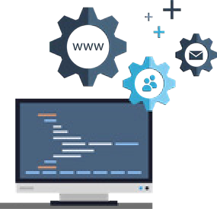














Infrastructure | Cloud Service auto-scaling
Automatically detects the need for increased capacity and scales dynamically
CDN
Vertical Scaling
Adds additional memory
or processing to current system s
Developer
Non-production environments (Dev, UAT…)
Staging and Production environments
Publish farm
Horizontal Scaling
Adds as many new nodes as needed for high performance
Author cluster
Author
© 2021 Adobe. All Rights Reserved

Slide 14





Infrastructure | Managed Services
Scale and expertise paired with cloud-native capabilities
Accelerate Agility
Automate and shorten development cycles with Cloud Manager CI/CD to deliver digital experiences faster.
Maximize ROI
Improve developer productivity with a simplified upgrade experience for increased adoption of new features.
Minimize Disruptions
Simplify process automation and ensure business continuity with auto-scaling, self-service capabilities, and high SLAs.
Security in Depth
Minimize risk of security threats or downtime with best-in-class security coverage and testing.
© 2021 Adobe. All Rights Reserved

Slide 15
Cloud Manager | AEM Environments
Services within an environment
AEM Author
AEM Publish
Dispatcher
Types of Environments
Dev
Stage
Prod
Environment
Author Service
Publish Service
Dispatcher
Adobe Pipeline
Dev Environment
Stage Environment
Prod Environment
© 201251 Adobe. All Rights Reserved
15

Slide 16
Cloud Manager | Developer Notes
Develop Local
AEM builds can be run locally
Dispatcher validation can be tested locally
Maven projects are used for development
Projects must be pushed into Git
Adhere to best practices enforced by CICD
More on Cloud Manager later…
© 201261 Adobe. All Rights Reserved
16

Slide 17





Evolution of Adobe Experience Manager in the Cloud
2021
AEM as a Cloud Service
Cloud-native solution with continuous innovation release
2017
Separate Content & Apps and Composite Repository with AEM 6.4
2018
Cloud-native functionality with Cloud Manager
2010
AEM moves to the cloud with Managed Services
AEM with Managed Services
Managed cloud with ongoing innovation & service releases
© 2021 Adobe. All Rights Reserved
17
ADOBE DIGITAL LEARNING SERVICES

Slide 18



What are the 4 architecture layers in an AEM? Select the correct answer.
Cloud Manager, JCR, Sling, and Applications
OSGi, JCR, Sling, and AEM Applications
OSGi, JCR, HTML, and Applications
OSGi, JCR, Sightly, and Cloud Manager
Knowledge check
© 201281 Adobe. All Rights Reserved. Adobe Confidential.
18
ADOBE DIGITAL LEARNING SERVICES

Slide 19
AEM provides Sites, Assets, Forms, and Screens Applications
AEM has an open source architecture that includes OSGi, Sling, and the JCR
Adobe provides two deployment options that include Cloud Service and Manage Services
Cloud manager is used as Adobe’s deployment tool
Key takeaways
© 2021 Adobe. All Rights Reserved. Adobe Confidential.
19

Slide 20
Install Adobe Experience Manager Locally
Objectives:
Understand local installation fundamentals
Install AEM as a Cloud Service Locally
Install AEM 6.5.x Locally
Install a service pack

Slide 21

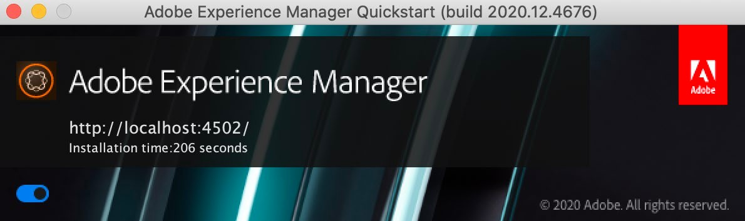
Local Installation Fundamentals
AEM runs on all operating systems that support Java SDK
All client interactions with AEM are done through a web browser Development occurs on a local instance of AEM
Installation Requirements
quickstart jar file
A valid AEM license key properties file (6.5 only)
Java 11
Approximately 4 GB of free space per Service
Approximately 4 GB of RAM (at the very minimum!)
© 2021 Adobe. 2All Rights Reserved
2
ADOBE DIGITAL LEARNING SERVICES

Slide 22

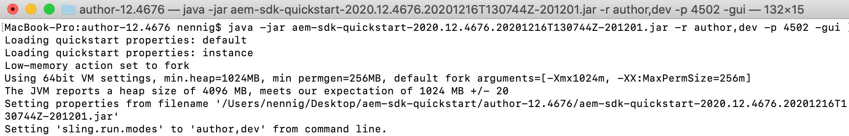
Install and Start AEM
“double-click on the jar” is only supported in AEM 6.5 and lower Command line is recommended
$ java –jar [Java options] <quickstart>.jar [AEM options]
AEM Options can include
o runmodes, port, launch browser, launch server gui, forked process, unpack and no install, debug
Learn more by viewing help $ java –jar <quickstart>.jar -h
© 2021 Adobe. 3All Rights Reserved
3
ADOBE DIGITAL LEARNING SERVICES

Slide 23
Install AEM as a Cloud Service Locally

Slide 24
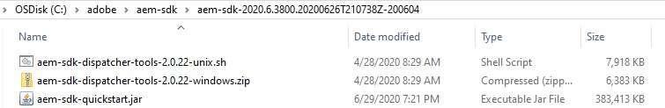
Cloud Service | AEM SDK
Super-set of tools used to develop for AEM as a Cloud service:
Quickstart Jar
The AEM runtime used for local development
Dispatcher Tools
The set of tools used to develop against Dispatcher locally
© 20251 Adobe. All Rights Reserved
5
ADOBE DIGITAL LEARNING SERVICES

Slide 25
Cloud Service | Download
Customer must have a valid maintenance or support contract to gain access to download Redownload every two weeks or as needed
Optionally develop on the specific build that cloud environments are using
Environment version can be found in Cloud Manager
Download the AEM SDK
https://experience.adobe.com/#/downloads/content/software-distribution/en/aemcloud.html
Learn about the latest release
https://experienceleague.adobe.com/docs/experience-manager-release-information/aem-release- updates/aem-releases-updates.html
© 20621 Adobe. All Rights Reserved
6
ADOBE DIGITAL LEARNING SERVICES

Slide 26
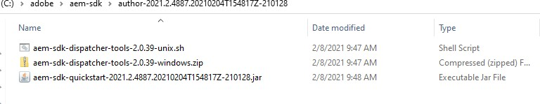
Cloud Service | Create the install folder
Extract the SDK
o Extracted folder contains the quickstart jar
Install via command line
$ java –jar aem-sdk-quickstart.jar -r author,dev -p 4502 –gui
Author indicates author service while dev indicates the environment type
Note: The name aem-sdk-<build>.jar has been renamed to aem-sdk-quickstart.jar for simplicity.
© 20271 Adobe. All Rights Reserved
7
ADOBE DIGITAL LEARNING SERVICES

Slide 27

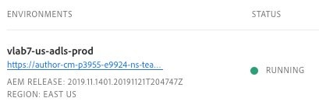
Refresh AEM SDK | Quickstart and API
Cloud Service Only
Cloud Service runs on continuous releases
Daily maintenance releases will have minimal changes in the SDK
Monthly maintenance releases will typically have more impactful changes
Adobe recommends refreshing the SDK at least after a monthly maintenance release
When you download a new SDK, update your POM with the same release number
Optionally use same release as Production service
Can easily be found in Cloud Manager
© 2021 Adobe. All Rights Reserved
8
ADOBE DIGITAL LEARNING SERVICES

Slide 28
Exercise 1: Install the AEM SDK Quickstart Jar
Exercise
© 2021 Adobe. All Rights Reserved. Adobe Confidential.
9
ADOBE DIGITAL LEARNING SERVICES

Slide 29
Install AEM 6.5.x Locally

Slide 30

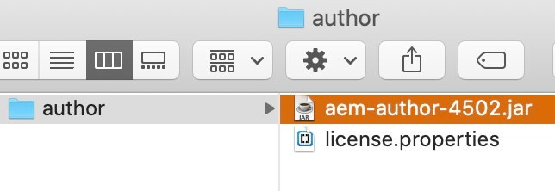
AEM 6.5.x | Download
Customer must have a valid maintenance or support contract to gain access to download AEM quickstart jar and license. Properties file
https://licensing.adobe.com/
Business partners can email spphelp@adobe.com
Dispatcher
https://experienceleague.adobe.com/docs/experience-manager-dispatcher/using/getting- started/release-notes.html
© 2021 Adobe. All Rights Reserved
11
ADOBE DIGITAL LEARNING SERVICES

Slide 31

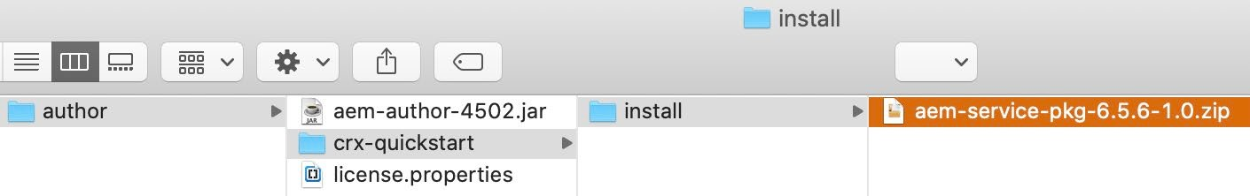
AEM 6.5.x | Service Packs
Available Quarterly
Download latest Service Packs
https://experience.adobe.com/#/downloads/content/software-distribution/en/aem.html
Learn about the latest release
https://experienceleague.adobe.com/docs/experience-manager-release-information/aem-release- updates/aem-releases-updates.html
Can be installed during install or through Package Manager post install
© 2021 Adobe. All Rights Reserved
12
ADOBE DIGITAL LEARNING SERVICES

Slide 32
AEM 6.5.x | Create the install folder
Create folders ~/author/crx-quickstart/install
Under ~/author add the AEM 6.5 jar file and license file
Under ~/author/crx-quickstart/install add the desired service pack zip
Install via command line
$ java –jar aem-4502-author.jar -r author,dev -p 4502 –gui
Author indicates author service while dev indicates the environment type
You can optionally double click on the jar to start AEM
© 201231 Adobe. All Rights Reserved
13
ADOBE DIGITAL LEARNING SERVICES

Slide 33
Install AEM 6.5 and Service Pack
Exercise
© 2021 Adobe. All Rights Reserved. Adobe Confidential.
14
ADOBE DIGITAL LEARNING SERVICES

Slide 34

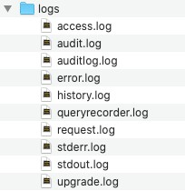
AEM Log Files
AEM logging is based on Sling logging Sling logging exports four logging APIs:
Simple Logging Facade for Java (SLF4J)
Apache Commons Logging
Log4j
java.util.logging
By default, the error, access, history, and request logs rotate once per day
© 2021 Adobe. All Rights Reserved
15
ADOBE DIGITAL LEARNING SERVICES

Slide 35
Exercise 3: Observe the local log files
Exercise
© 2021 Adobe. All Rights Reserved. Adobe Confidential.
16
ADOBE DIGITAL LEARNING SERVICES

Slide 36

Local Installation Fundamentals
AEM runs on all operating systems that support Java SDK
All client interactions with AEM are done through a web browser
Development occurs on a local instance of AEM
Super-set of tools used to develop for AEM as a Cloud service:
Quickstart Jar
Dispatcher Tools
AEM 6.5.x
AEM quickstart jar and license. Properties file
Dispatcher
Key takeaways
© 2021 Adobe. All Rights Reserved. Adobe Confidential.
17
ADOBE DIGITAL LEARNING SERVICES

Slide 37
Front-end Development with aemfed
Objectives:
Describe benefits of aemfed
Install aemfed
Develop using aemfed

Slide 38

Node.js® and NPM
Node.js
Asynchronous event driven JavaScript runtime
Built on Chrome V8 JavaScript engine
Node Package Manager (NPM)
CLI package manager
Manages an online repository of open source node.js packages
Manages dependencies for Node.js packages
© 2021 Adobe. All Rights Reserved

Slide 39
aemfed
Open-source, command-line tool used to speed up front-end development
URL to the open source project - https://aemfed.io/
It is powered by
aemsync
Browsersync
Sling Log Tracer
© 2021 Adobe. All Rights Reserved

Slide 40
Why aemfed?
Listens for file changes and, using aemsync, automatically syncs to an AEM instance
Determines which clientlibs are affect by the uploaded changes
Browsersync communicates with all tabs of your browser that are open to AEM pages, without any browser plugins
Styling changes are immediately injected without a reload, maintaining the state of the page
All other changes, result in a page reload/refresh
Works with the Sling Log tracer to automatically display any front-end related, server-side errors directly in the terminal window
© 2021 Adobe. All Rights Reserved

Slide 41

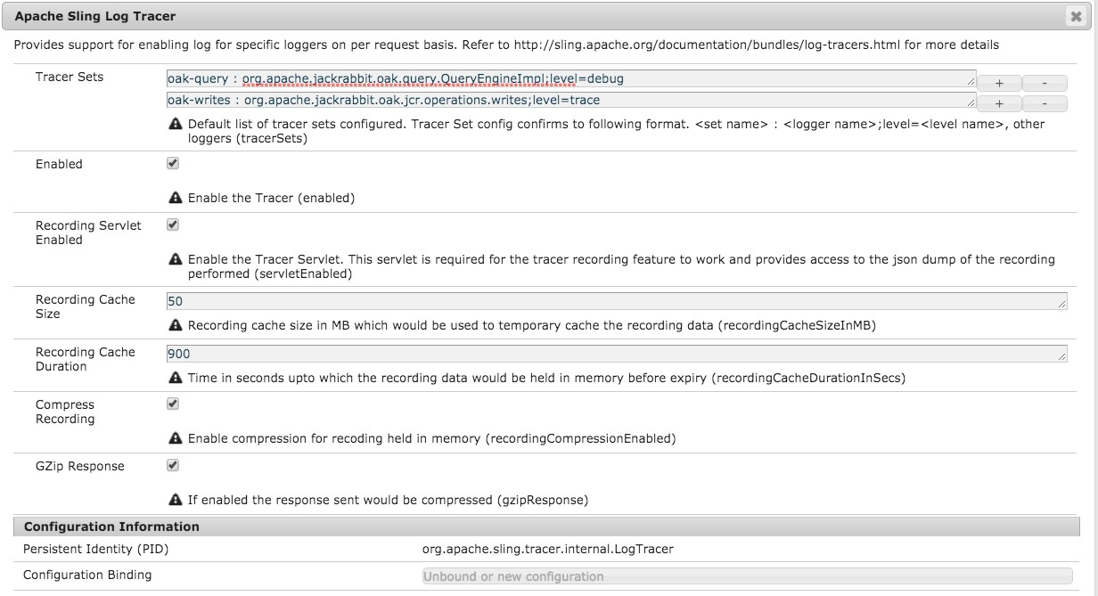
Enabling the Apache Sling Log Tracer
© 2021 Adobe. All Rights Reserved

Slide 42
Exercise 1 - Install Node.js and NPM Exercise 2 – Configure and run aemfed
Exercise 3 – Install content locally (optional)
Exercise
© 2021 Adobe. All Rights Reserved. Adobe Confidential.
6
ADOBE DIGITAL LEARNING SERVICES

Slide 43

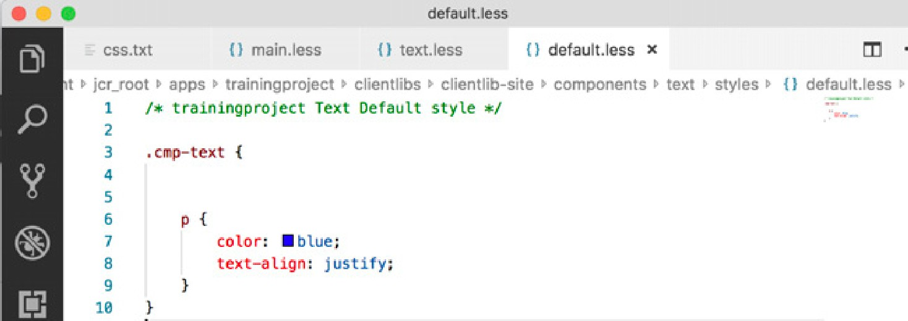

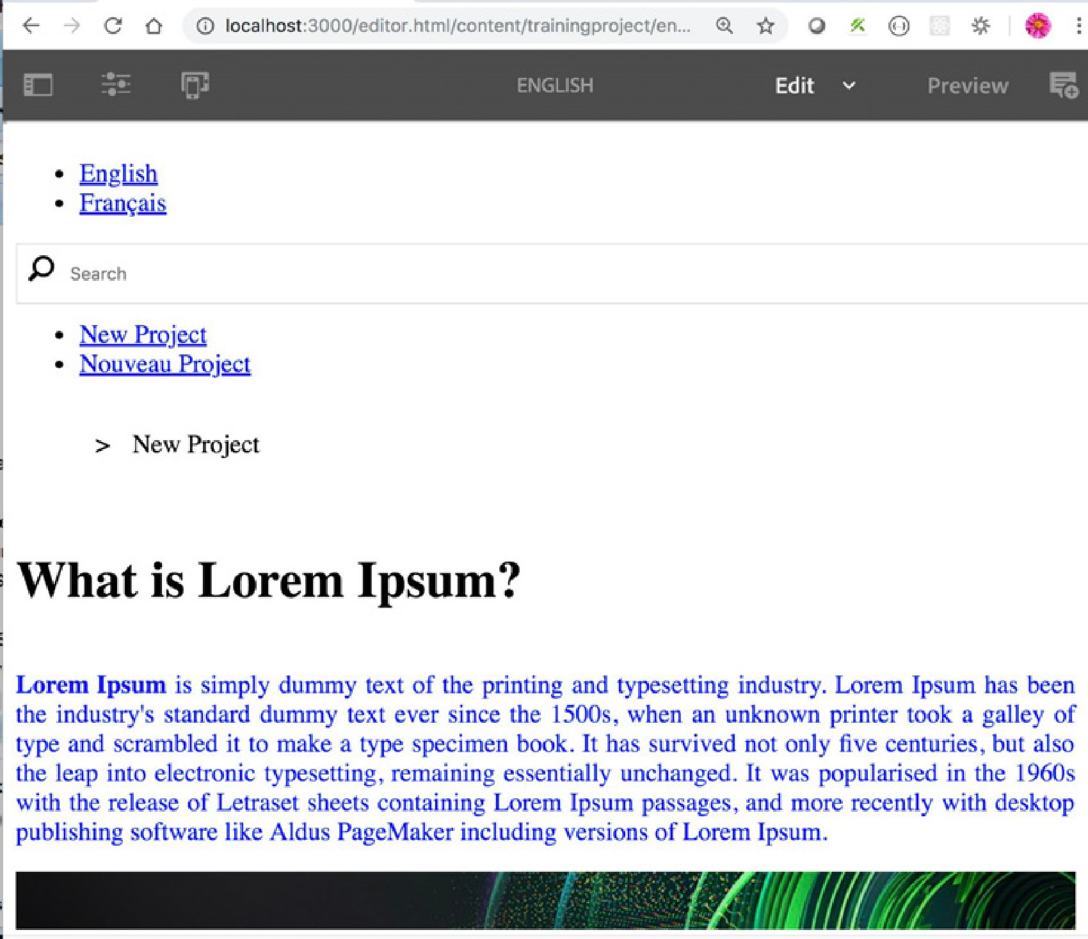
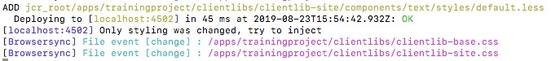
aemfed Watches File Changes
© 2021 Adobe. All Rights Reserved
43

Slide 44

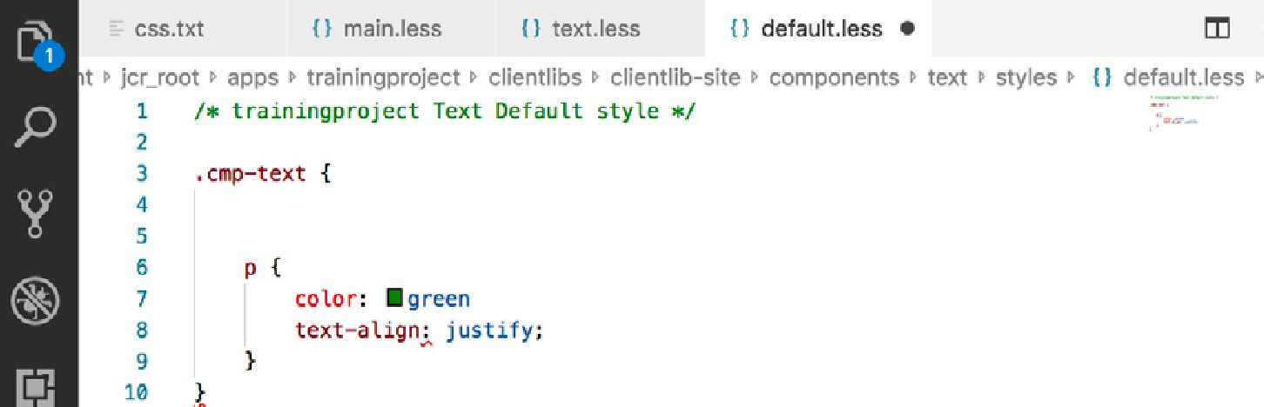

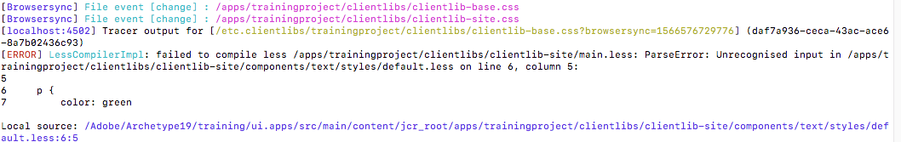
Apache Sling Log Tracer Displays Errors
© 2021 Adobe. All Rights Reserved
44

Slide 45
Exercise 4: Add a component style using aemfed
Exercise
© 2021 Adobe. All Rights Reserved. Adobe Confidential.
45

Slide 46
Key Takeaways:
Node.js
Enables developers to use JavaScript to write command line (CLI) tools and for server-side scripting
aemfed
Open-source, command-line tool used to speed up front-end development
Listens for file changes and, using aemsync, automatically syncs to an AEM instance
Works with the Sling Log tracer to automatically display any front- end related, server-side errors directly in the terminal window
Key takeaways
© 2021 Adobe. All Rights Reserved. Adobe Confidential.
46

Slide 47
Assets Authoring Basics
Objectives:
Navigate through the Assets console
Create folders
Upload assets to a folder
Explain the basics of asset metadata
Add metadata to an asset

Slide 48
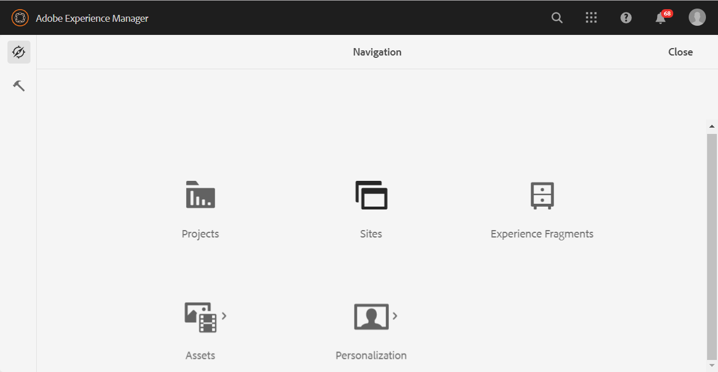
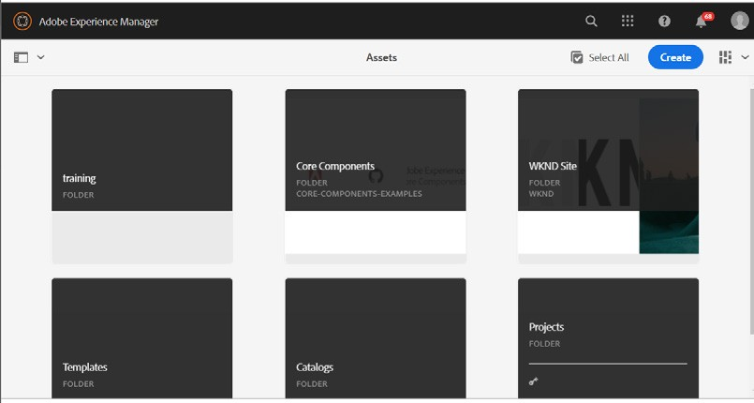
Assets Console
You can access the Assets console from the Navigation panel.
Within the Assets console, you can import and manage digital assets, such as images, videos, documents, and audio files.
o You can then use these assets on any website that runs on the same AEM Service.
© 2021 Adobe. All Rights Reserved

Slide 49
Adobe Experience Manager Assets
Find assets easier with metadata and tags
Manage a single, global asset repository Track projects, tasks, and workflows
With Assets, you can:
Simplify search and sharing of asset collections
Reveal the ROI of digital assets with asset insights and analytics
Reduce the cost of asset management
© 2021 Adobe. All Rights Reserved

Slide 50

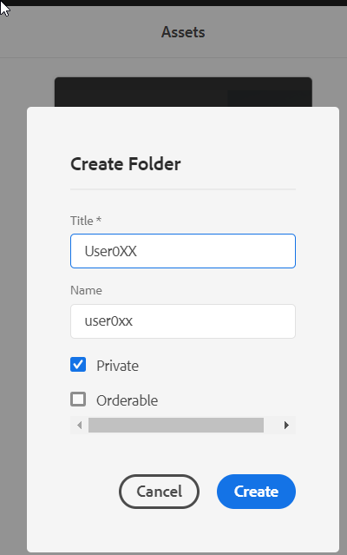
Creating Folders
You can organize assets by storing them in separate folders.
Folder can either be private or public.
Private folders – accessed only by the creator.
Public folder – accessible to all the users in the organization.
Key fields when creating an asset folder:
Title:
Displayed to the user in the console and is at the top of the content page when editing.
This field is mandatory.
Name
Used to generate the Uniform Resource Identifier (URI).
The user input for this field is optional.
© 2021 Adobe. All Rights Reserved

Slide 51
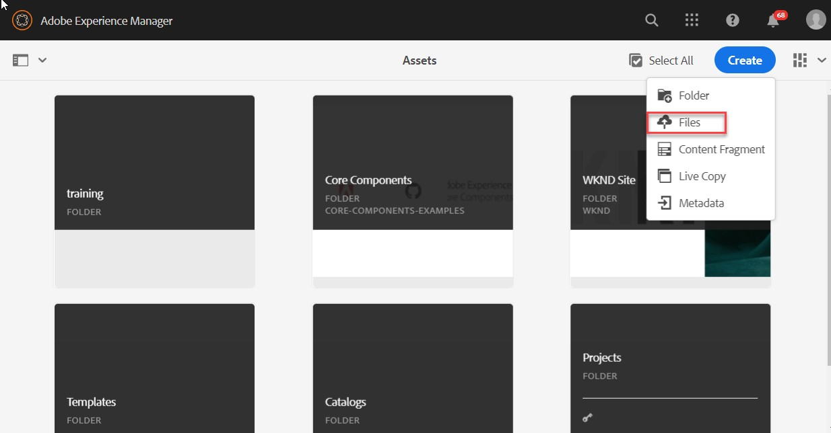
Uploading Assets
You can upload Assets by:
o Clicking the blue Create button
o Dragging and dropping files into the browser
o Using the AEM Desktop App
o Accessing Adobe Asset Link
All assets go through the DAM Update Asset ingestion process
© 2021 Adobe. All Rights Reserved

Slide 52
Exercise 1 - Create a folder and upload assets to it
Exercise
© 2021 Adobe. All Rights Reserved. Adobe Confidential.
6
ADOBE DIGITAL LEARNING SERVICES

Slide 53

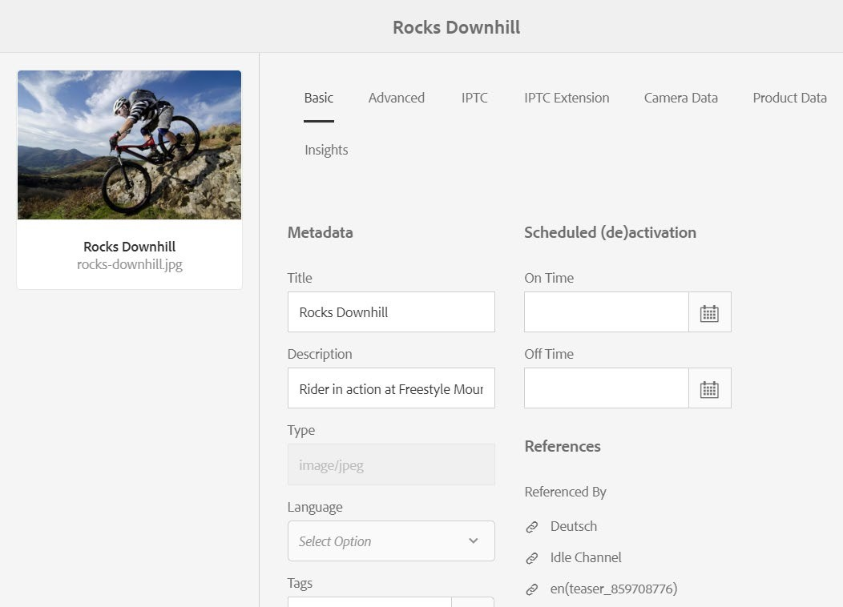

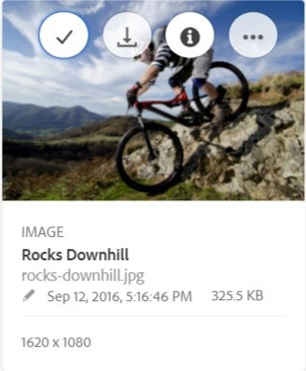
Asset Properties
Expose metadata, references, product info, and asset insights
© 20271 Adobe. All Rights Reserved
7
ADOBE DIGITAL LEARNING SERVICES

Slide 54





Metadata Schemas
Can be viewed under Asset properties
Can be read or read/write
Adobe Experience Manager (AEM) supports:
Default – standard metadata for all assets
Image – image specific metadata
.jpg
.png
Application
.pdf
Video
Collection, Content Fragment, and Forms – unique asset types to AEM
Custom metadata schemas are typical in AEM Assets.
© 2021 Adobe. All Rights Reserved
54

Slide 55

Metadata
Common properties
Title/Description
Tags
Technical metadata
Digital Rights Management
Owner/Contributor
Copyright Info/Expiration
IPTC metadata Camera Data Product Data
Asset Insights (Adobe Analytics)
© 2021 Adobe. All Rights Reserved
55

Slide 56
Exercise 2 - Add metadata to an asset
Exercise
© 2021 Adobe. All Rights Reserved. Adobe Confidential.
56

Slide 57

Assets Authoring Basics:
https://docs.adobe.com/content/help/en/experience-manager-cloud- service/assets/home.html
References
© 2021 Adobe. All Rights Reserved. Adobe Confidential.
57

Slide 58
Cloud Manager Basics
Objectives:
Describe Cloud Manager
Understand basic Cloud Manager terminology
Set up Program
Define Pipeline with existing repository
Explain custom code quality rules

Slide 59




Deployments for Adobe Experience Manager
6.5 and lower
6.4.x and 6.5.x
AEM as a Cloud Service
Cloud Manager
+ Self service
On-Premise deployment
Adobe Managed Services
Self service
Adobe Experience Manager on a customer/partner managed deployment
Adobe Experience Manager on Managed Services with Cloud Manager
Adobe Experience Manager as a Cloud Service
© 2021 Adobe. All Rights Reserved
2
ADOBE DIGITAL LEARNING SERVICES

Slide 60







On-Premise Traditional Deployment Workflow
QA
Operations
Developer
Customer Repo
Dev/QA
Staging
Production
UAT
Many times per day
Many times per sprint
Once per sprint
Once per release
© 2021 Adobe. All Rights Reserved.
60

Slide 61

Cloud Manager Deployment Workflow
QA
Operations
Pull
Push
Developer
Customer Repo
CM Repo
Dev/QA
Staging
Production
UAT
Cloud Manager
develop/release
master
© 2021 Adobe. All Rights Reserved.
61

Slide 62



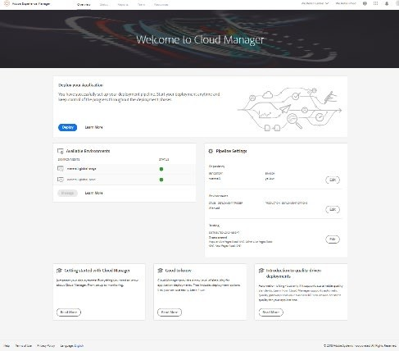

Cloud Manager for Adobe Experience Manager
Self Service Portal
Easily access & manage the cloud environment and CI/CD pipeline
CI/CD Pipeline
Code inspection, performance testing, and security validation
Flexible Deployments
Schedule code deployments during specified time frames
Auto-scaling
Detects the need for additional capacity during unexpected spikes
62

Slide 63

Cloud Manager Entities
Cloud Manager is the single entry point for the Operations and Developer Personas to create and manage environments for the Adobe Experience Manager application
Programs
Environments
Pipelines
Self-service creation of AEM applications (AEM Sites, AEM Assets) with associated code repository
Self-service creation of AEM environments (production and non-production – for example, demos, POC, training…)
Self-service creation of CI/CD pipelines for best practices
63

Slide 64
Hierarchy of entities in Cloud Manager
Adobe Experience Cloud organization
Cloud Manager
Adobe Experience Cloud Core Services
Admin Console
Launch
Adobe Experience Platform
Program 1
Program 2
Program 3
Program 4
Code Repository
Branch 1
Branch 2
Branch …
Environments
…
Pipelines
Prod
Stage
Dev 1
Dev x
Tools for self service
Developer Console Access
Access Environments
Add and Manage Environments
Configure and Deploy Pipelines
Manage Git
Download Logs
64

Slide 65
Environments
0-many Dev Environments
0-1 Stage/Prod Environment set
Environments Consist of
Author, Publish, and Dispatcher
Environments are Autoconfigured with
Replication
Cloud native microservices
Sensei Features like Smart Tag and Smart Crop
Adobe IMS for authentication
Retrievable Logs
Environments
Prod
Author
git code
Publish
Dispatcher
Adobe CDN
git code
git code
Stage
Author, Publish, Dispatcher
git code
Dev 1
Author, Publish, Dispatcher
Dev x…
…
65

Slide 66
Environments UI
66

Slide 67
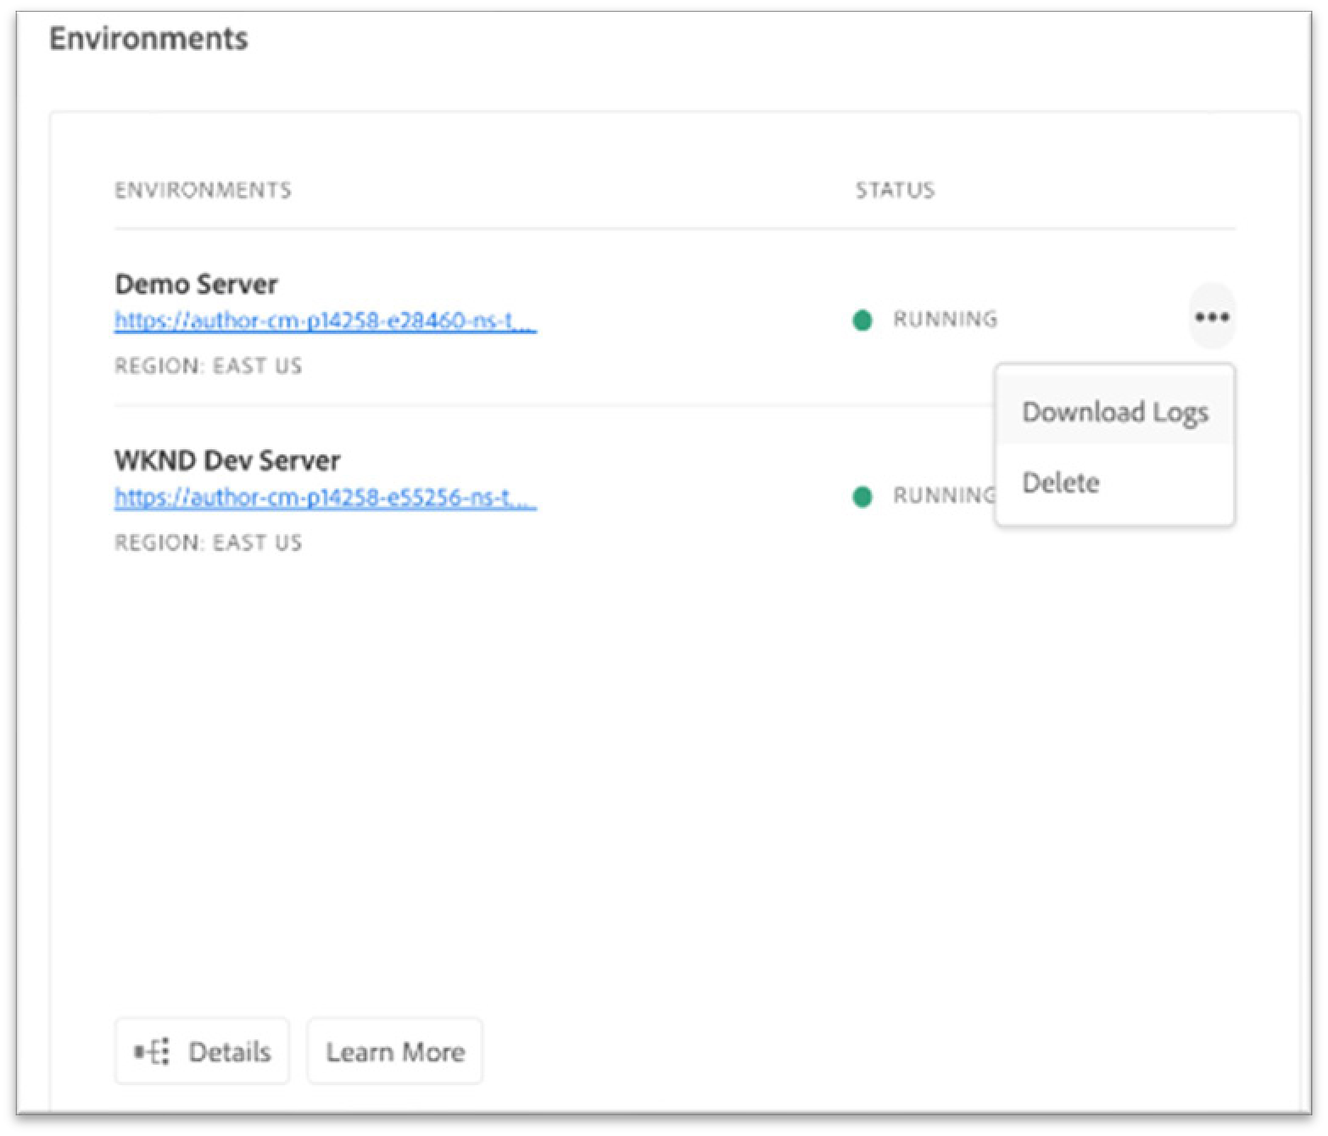
Environments | Logs
Downloadable Author or Publish Logs:
aemaccess.log
aemerror.log
aemrequest.log
Downloadable Dispatcher logs:
aemdispatcher.log
httpdaccess.log
httpderror.log
Logs available through
Cloud Manager UI
aio-cli cloudmanager plugin
o Download or tail logs
67

Slide 68
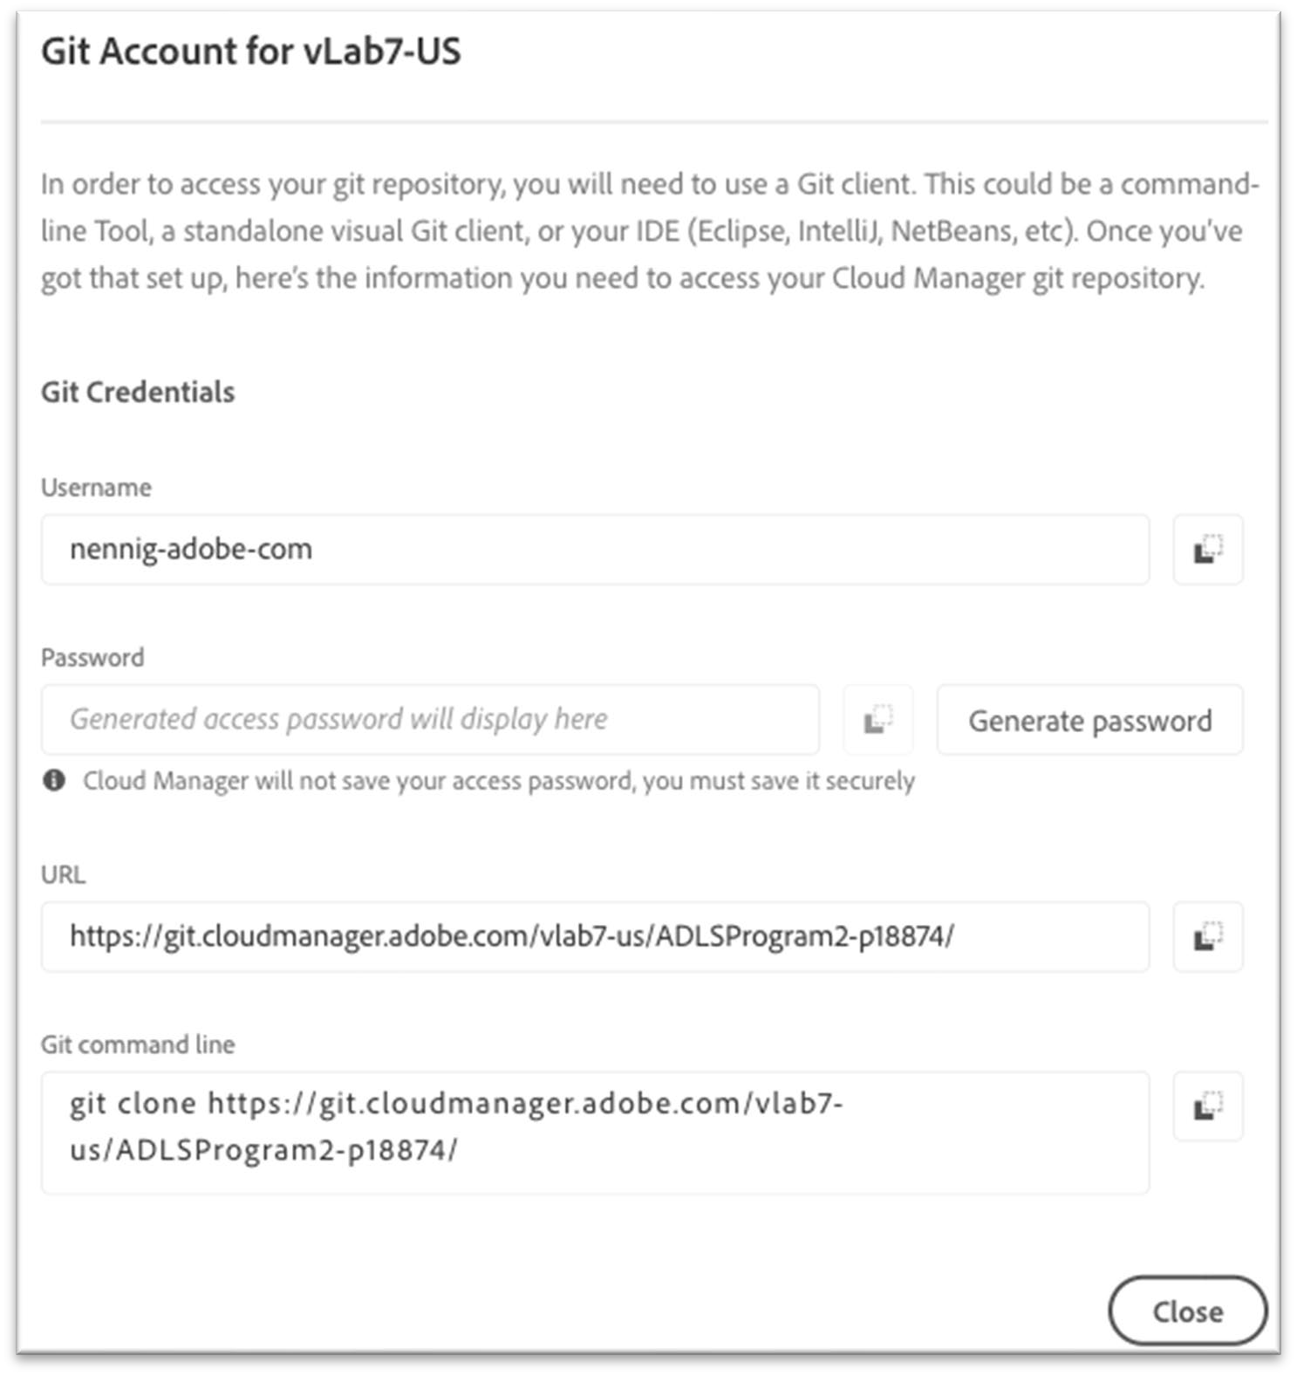

Code Repository
1 git repository to 1 Cloud Manager Program
Access git account through a Git client using HTTPS Different Branches can be used on different pipelines
feature1 branch > code quality pipeline
develop branch > QA pipeline
main branch > production pipeline
Completed Production pipelines
Auto create a release tag
Tags can be pulled back to customer repos
68

Slide 69
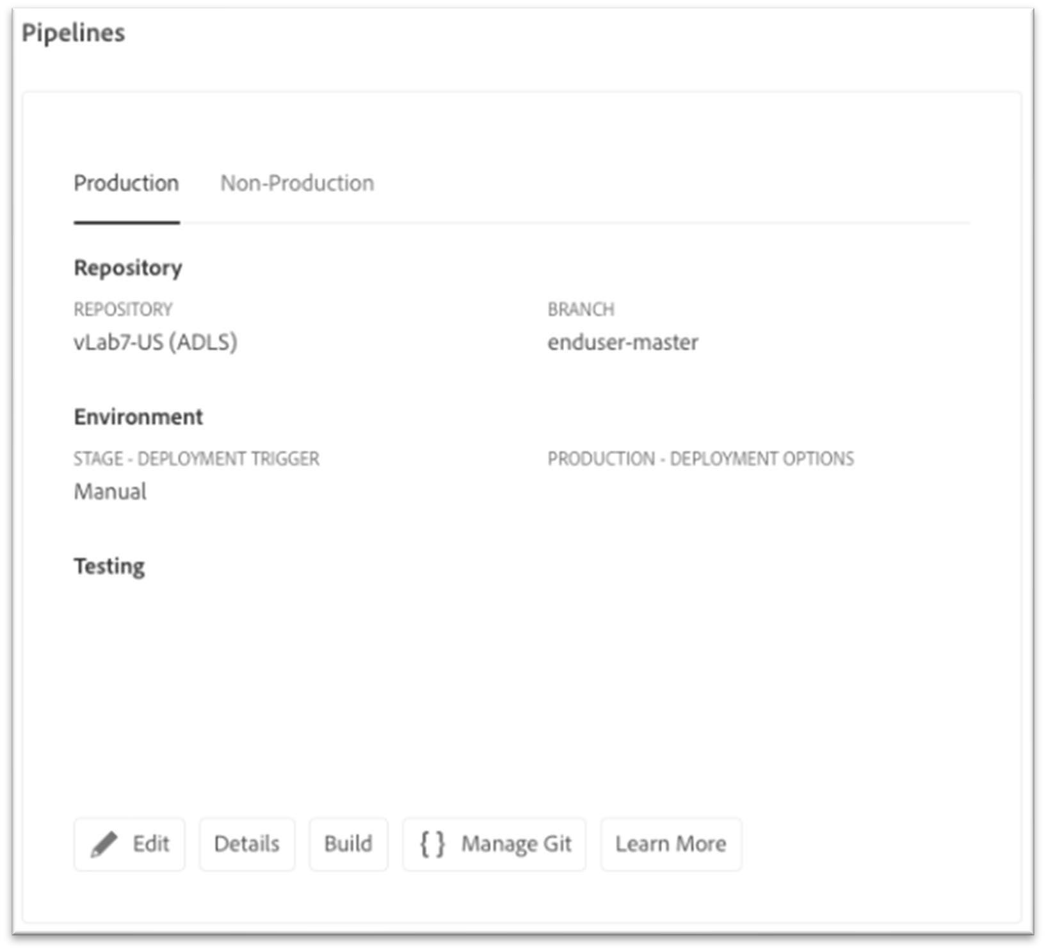
Pipelines
Goals of pipelines
Run robust set of tests throughout all stages
Build an image with a git branch and AEM build
Deploy the image to an environment (optional) Triggered based On Git Changes or Manual Configured Failure Behavior (non-critical)
Ask every time
Fail Immediately
Continue Immediately
Types of pipelines
Non-production code quality
Non-production deployment
Production

Slide 70
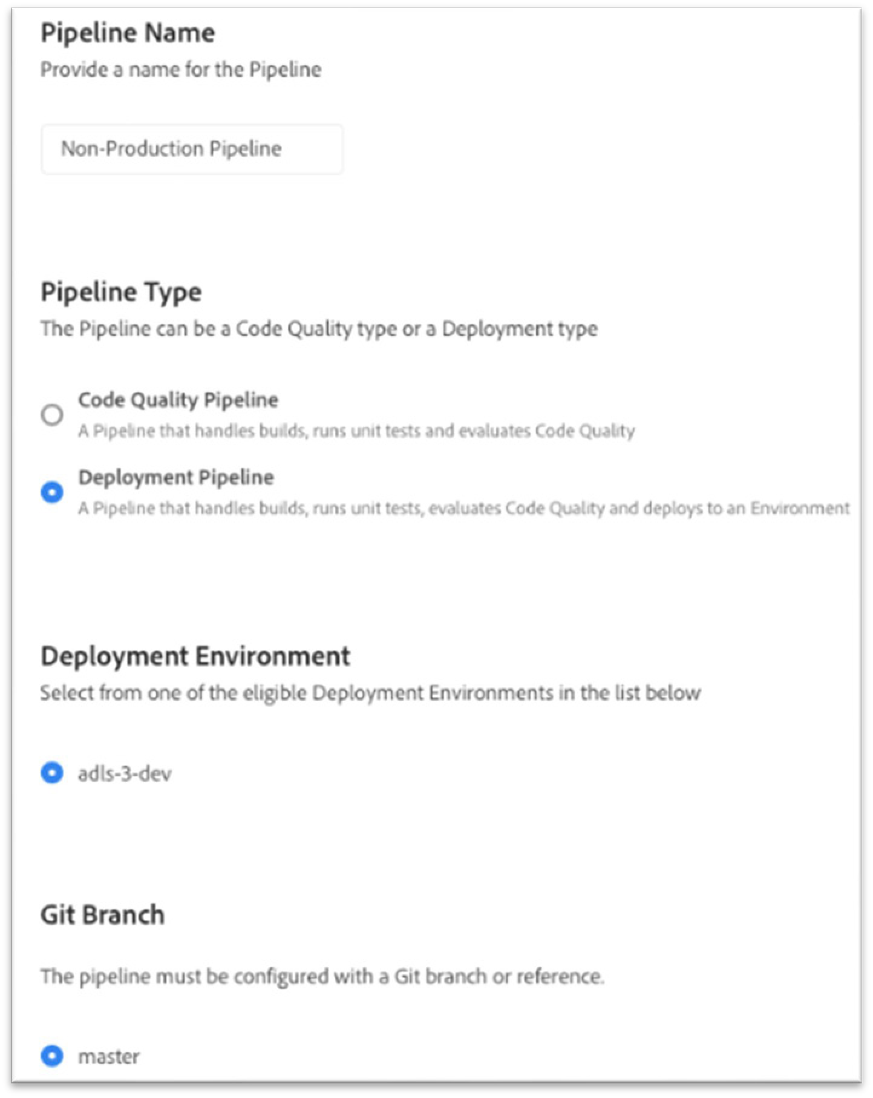
Pipelines | Non-Production Setup
0 to many pipelines
Types: Code Quality or Deployment
Deployment Env (not needed for Code Quality)
Git Branch (code to deploy)
Pipeline Options (trigger and failure behavior)
Non-Production types
Code quality: Checks code quality
Deployment: Checks code quality and deploys to a dev environment

Slide 71
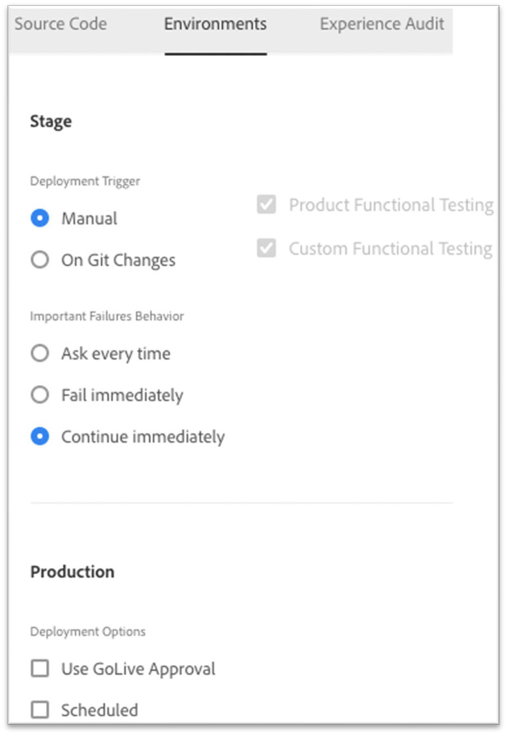
Pipelines | Production Setup
Can only have 0 to 1 production pipelines Source Code
Select a git branch
Environments – Stage Options
Trigger
failure behavior
testing decisions
Environments - Production Options
GoLive Approval
Scheduled
CSE Oversight (Managed Services only)
Dispatcher invalidation (Managed Services only)

Slide 72
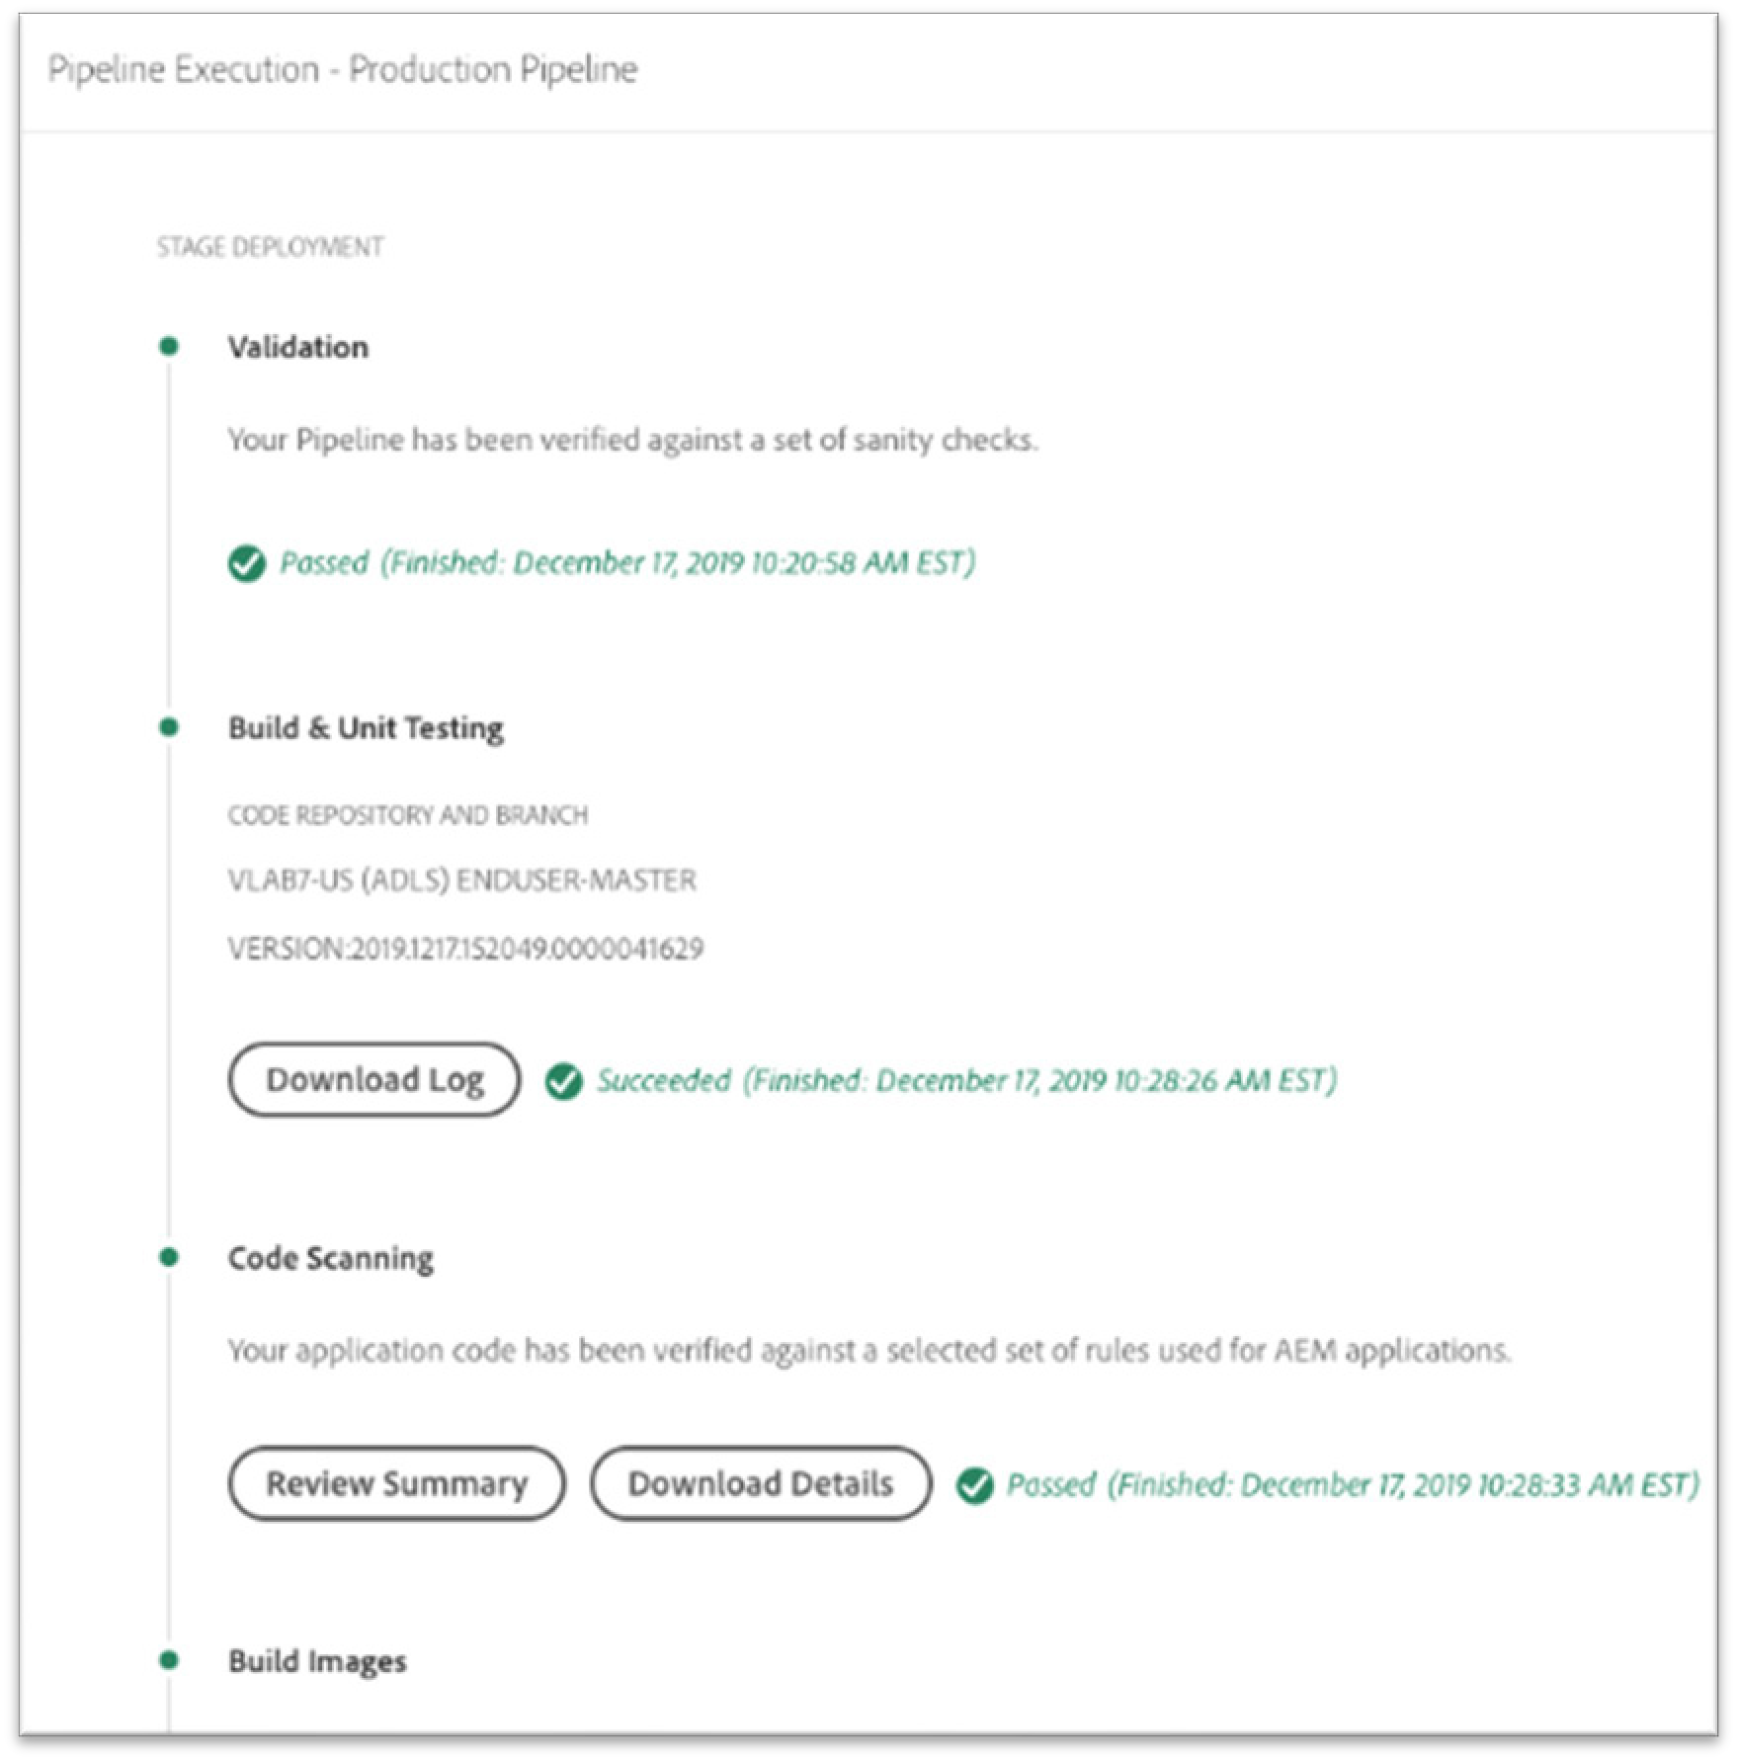
Pipelines | Stages
Dev and Stage Deployment
Validation (sanity checks)
Build & Unit testing
Code Scanning
Build Images
Deploy Environment
Testing (Stage only)
Product Functional Testing
Custom Functional Testing
Custom UI Testing
Experience Audit Testing
Prod Deployment (Prod only)
1. Deploy to production

Slide 73
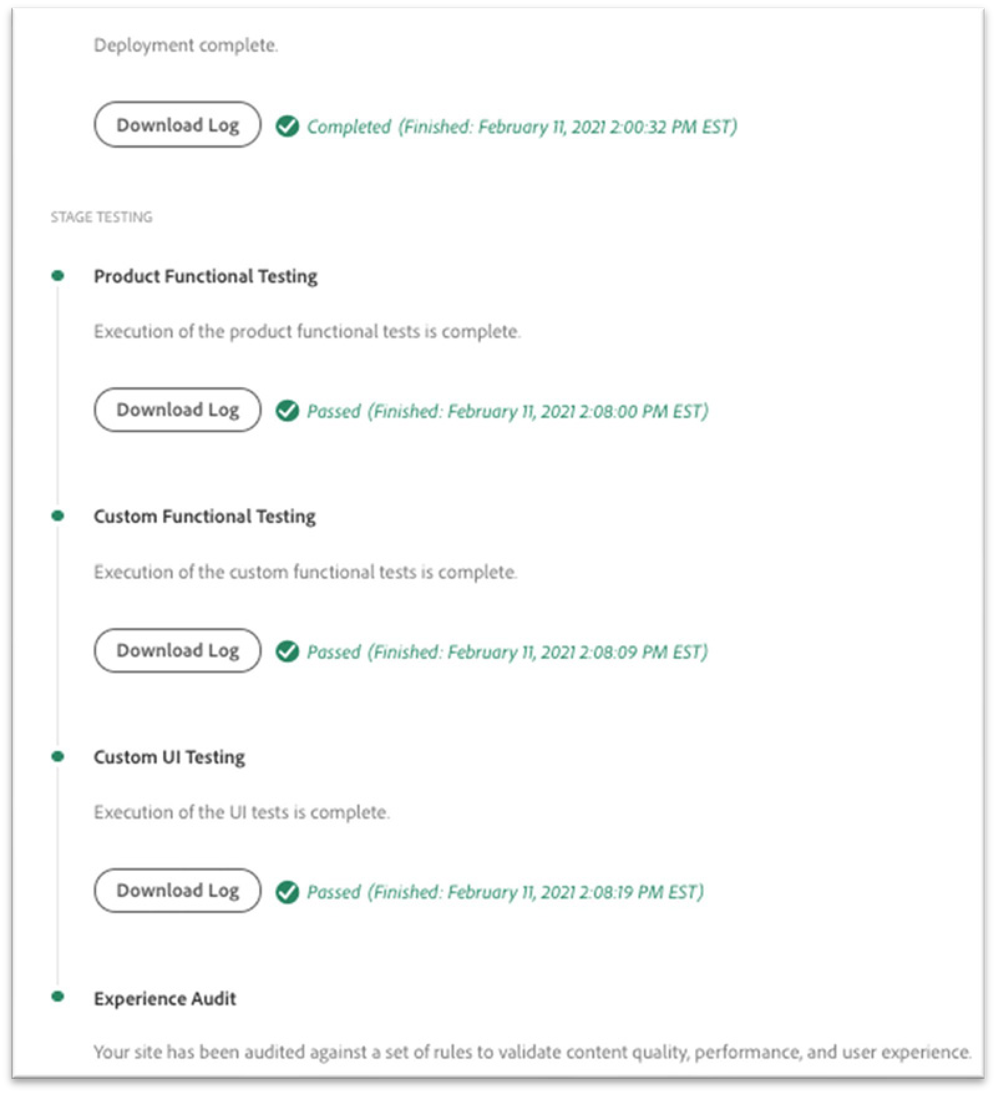
Testing in Pipelines
All pipelines
Unit Testing
Code Quality Testing
Production Pipelines only
Functional Testing
UI Testing
Experience Audit Testing
Tests can be
Customers written
Adobe written
Open-source tools

Slide 74
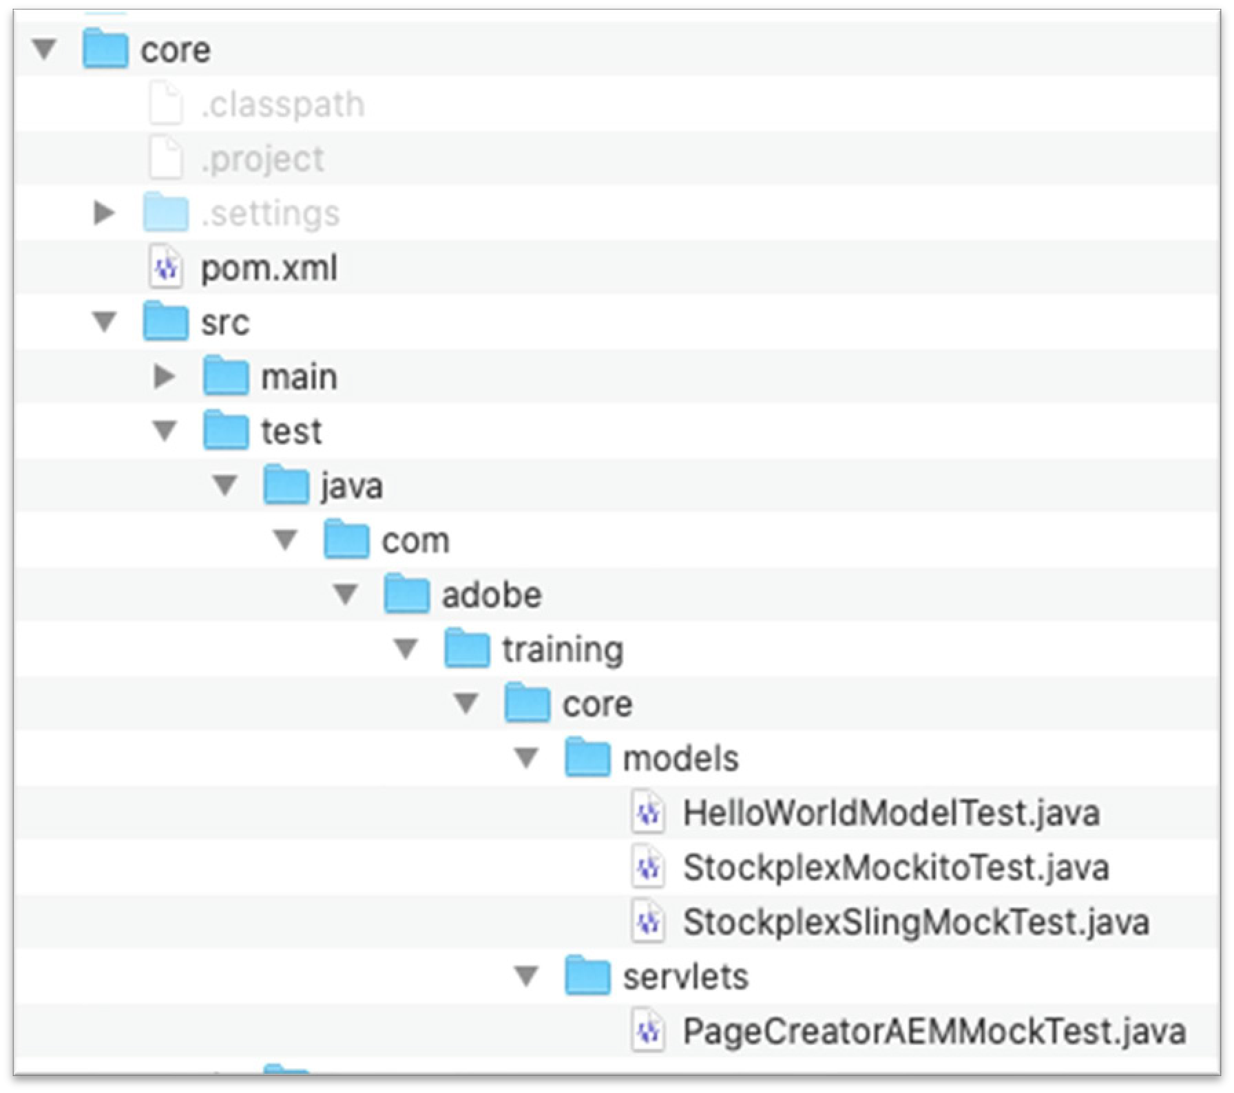
Testing | Unit
Pipelines: All
Unit testing is run through Maven Common mocking frameworks
Mockito
Sling Mocks
AEM Mocks
Unit tests are always run as apart of the Maven build process
Unit tests can be explicitly run locally by using Maven
$ mvn test

Slide 75
Testing | Code Quality
Pipelines: All
Analyzed using SonarQube rules Issues are grouped into 3 categories
Code Smell (Maintainability domain)
Bug (Reliability domain)
Vulnerability (Security domain)
Rules executed:
Squid - Standard SonarQube Java rules
Sonar Plugins
AEM – AEM Rules (By Cognifide)
CQ – Cloud Manager Rules (By Adobe)

Slide 76
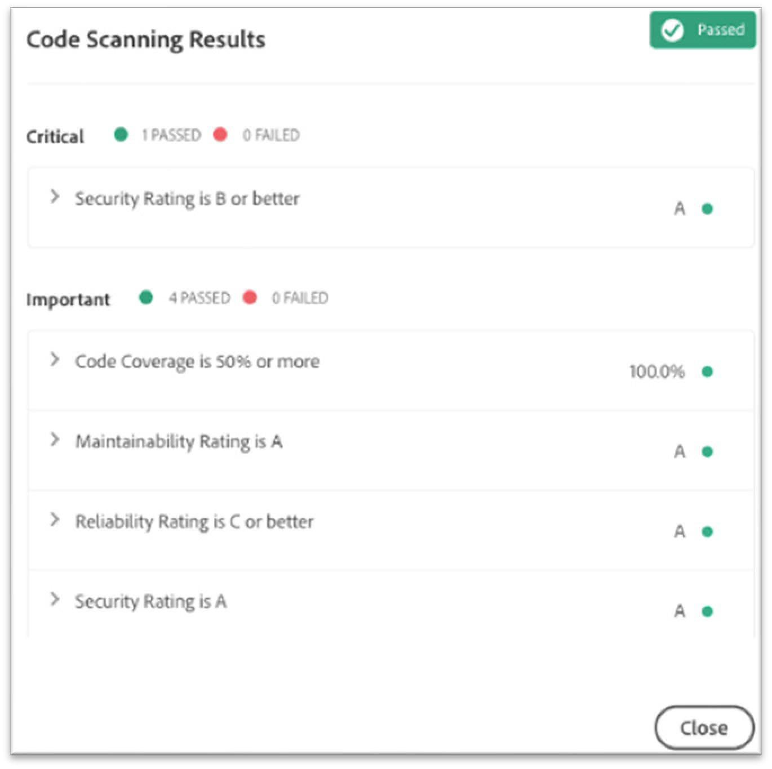
Testing | Code Quality Results
Pipelines: All
Quality is focused on
Security Rating
Reliability
Maintainability
Code coverage
Groups are separated into 3 severity levels
Critical – fails the pipeline. Must be fixed to continue
Important – Pauses the pipeline. Can be overridden or ignored
Information – No impact on the pipeline execution
SonarQube produces a CSV report of all issues

Slide 77

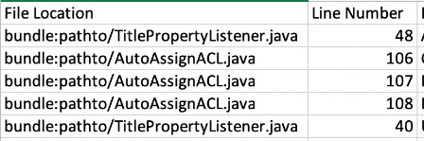

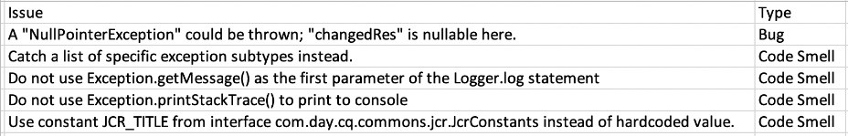

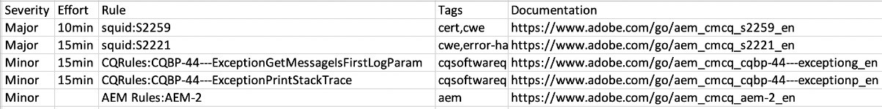
Example CSV output
Pipelines: All
Exact file, line#, what to fix and how long
Full categorization (Type, Severity, Rule, Tags) Quick documentation links

Slide 78

Exercise 1: Observe the custom code quality rules
In this exercise, you will observe the custom code quality rules output for a non-compliant Java file.
You will then observe the code quality rules created for code, which is fully compliant with the code rules.
Exercise
© 2021 Adobe. All Rights Reserved. Adobe Confidential.
22
ADOBE DIGITAL LEARNING SERVICES

Slide 79
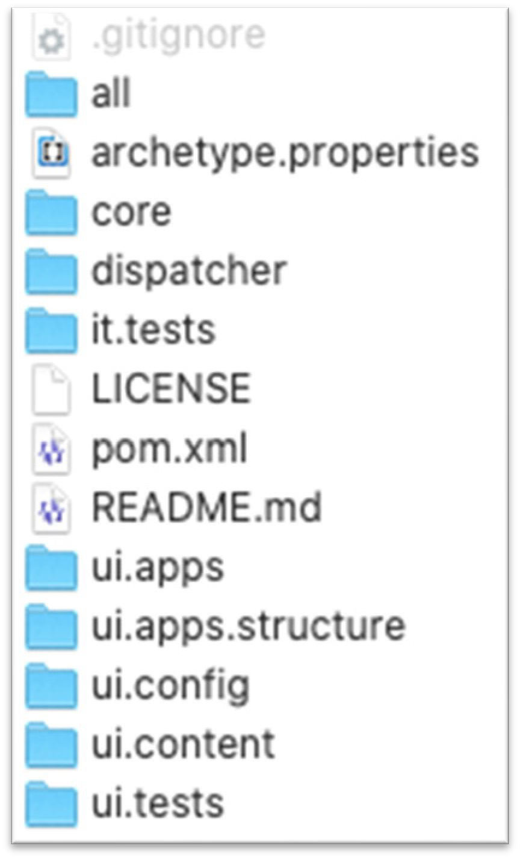
Testing | Functional and UI
Pipeline: Prod
The AEM Archetype can produce maven modules for Functional and UI tests Product Functional Testing (by Adobe)
Set of stable integration tests for AEM. Cannot be skipped
Custom Functional Testing (by Customer)
Separate testing jar build using a maven module
Auto-passes if no testing jar is present
UI Testing (By Customer)
Selenium-based tests packaged into a docker image
Tests can be written with Java, Node or other frameworks
Functional
UI

Slide 80
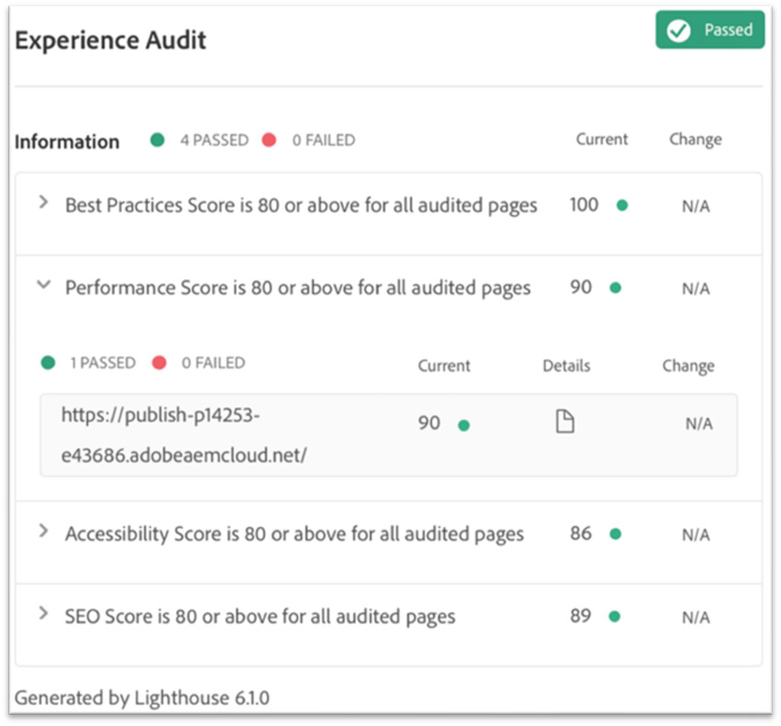
Testing | Experience Audit
Pipeline: Prod
Powered by Google Lighthouse that audits baseline standards for performance, accessibility, best practices and SEO
Results Produced:
Aggregate level metrics for average page score
Page specific level metrics available
Scores of individual test results
Result history informs website improvement
Aggregate scores explain
The page(s) have improved on the selected test
The page(s) have regressed on the selected test
No Change
No previous score available to compare to

Slide 81
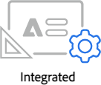
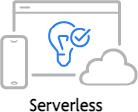
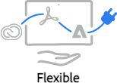
Adobe I/O
Adobe I/O is a single-entry point for communication with all Adobe solutions
Easy, secure, and fast way to access Adobe’s APIs
Can be accessed via UI or command line
Provides events and an API gateway
AEM uses Adobe I/O to connect to Sensei, Launch, Target, Analytics, etc All solutions connect to AEM with 2 primary steps:
IMS configuration through Adobe IO
Cloud Configuration in AEM for the solution

Slide 82
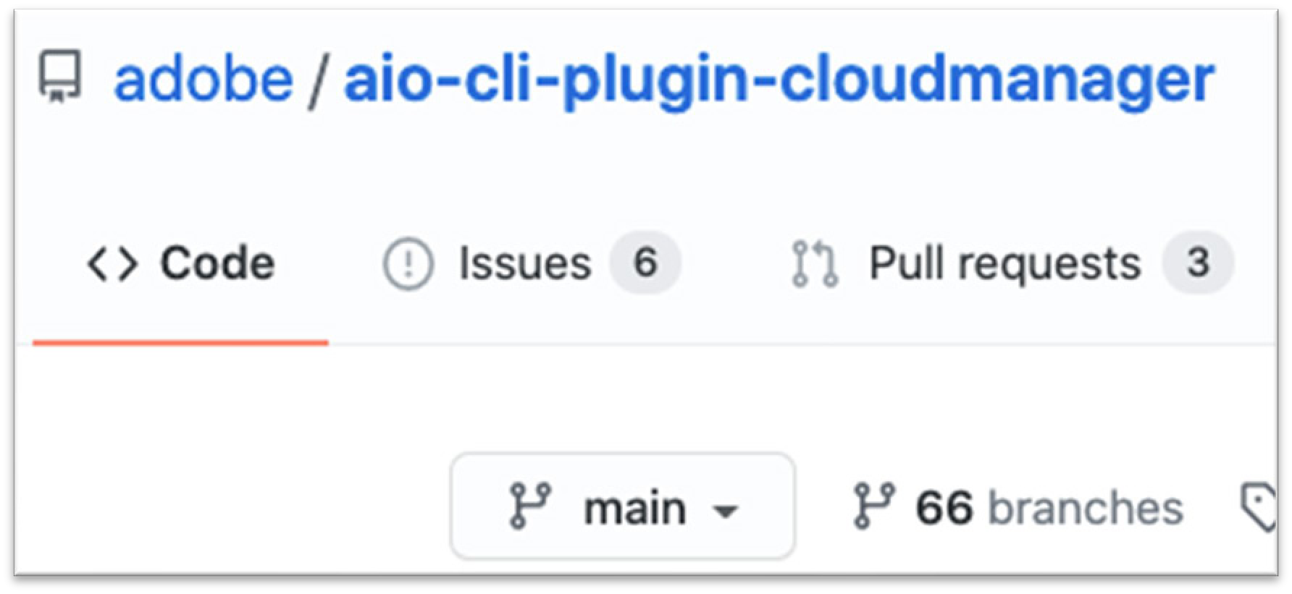
Adobe I/O | Cloud Manager
Adobe I/O provides a command line tool called aio-cli Cloud Manager offers a plugin for automation purposes
npm install @adobe/aio-cli-plugin-cloudmanager
Common commands available
List programs, environments, pipelines
Check pipeline status
Create/Delete/Advance a pipeline
Developer console and log access
Set environment variables

Slide 83








Adobe IO | Endless Possibilities
Run external tests
Start Pipeline
Cloud Manager
Webhook
On-Premise CI Engine
Events notifying external systems
Cloud Manager
On-Premise CI Engine
Cloud Manager
Webhook
Notification Channels
© 2021 Adobe. All Rights Reserved.
27
ADOBE DIGITAL LEARNING SERVICES

Slide 84
Cloud Manager enables organizations to self-manage Experience Manager in the cloud
Key Features
Self Service Interface
CI/CD Pipeline
Flexible Deployments
Autoscaling
Continuous Integration Pipeline: Promote code changes and eliminate manual processes remotely
Key takeaways
© 2021 Adobe. All Rights Reserved. Adobe Confidential.
28

Slide 85
Which of the following are part of Cloud Manager Environment? Select the three correct answers.
Author Instance
LDAP
Publish Instance
Dispatcher
Knowledge check
© 2021 Adobe. All Rights Reserved. Adobe Confidential.
29

Slide 86
Creating a project using Maven
Objectives:
Describe Maven
Install Maven command
Create project using Maven
Work with Maven project
Creating a project using Maven

Slide 87
Maven
Open-source development tool used to build and manage Java-based projects.
Describes how project is built, plugins needed, as well as its dependencies
Open-source artifacts are available on mavenrepository.com
Adobe artifacts are available on repo.adobe.com
Advantages
Build process is easier (after the project is set up properly)
Provides a uniform build system
Provides quality project information
Provides guidelines for development best practices
Allows transparent migration to new features
Project Object Model (POM) files are used as instructions for the Maven project
87

Slide 88
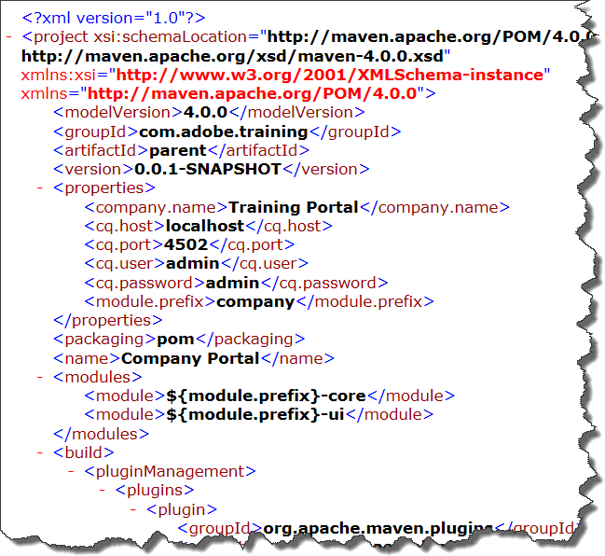
Understand POM Files
POM Files
Named pom.xml in the project structure
Exist at the project level (parent) and module level (sub-directories)
Identify all project artifacts and their dependency hierarchy
A POM file contains:
General project information
Build settings
Build environment
POM relationships and dependencies
Snapshot versions
Property references
Plug-ins
Sample POM file
88

Slide 89
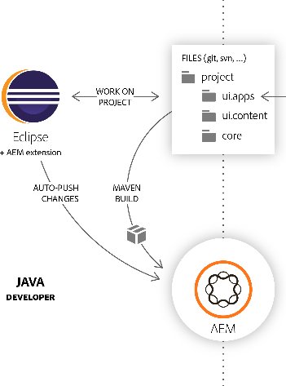
Using Maven for AEM Projects
Packages the Single Package artifact
Single Container for all bundles, content packages and 3rd party artifacts
Author and Publish maven profiles for installation
Builds OSGi bundle artifacts
Annotation driven java classes for OSGi
Development maven profile for installation
Builds Content Packages artifacts
Files and folders packaged for AEM
Development maven profile for installation
Manages artifacts for the project
Dependencies
Plugins
AEM SDK (CS) or UberJar (6.5 and older)
Unit Tests and Sling Tests
89

Slide 90
Exercise 1: Install Maven command
If you are using Readytech, you can skip this exercise.
Tasks to perform:
Install Maven
Configure Environment Variables
Install Node.js
Exercise
© 2021 Adobe. All Rights Reserved. Adobe Confidential.
5
ADOBE DIGITAL LEARNING SERVICES

Slide 91

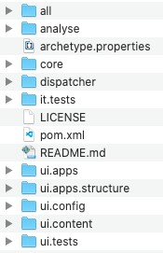
AEM Archetype
Used for rapid AEM project creation Cloud Ready
Standard for best practice
Mutable/immutable separation
Core Components
Multi-Site
Editable Templates
XF header/footer concept
Java example
Dispatcher for Managed Services or Cloud Service
Forms, Commerce, Webapp, Dynamic Media ready
https://github.com/adobe/aem-project-archetype#features
91

Slide 92
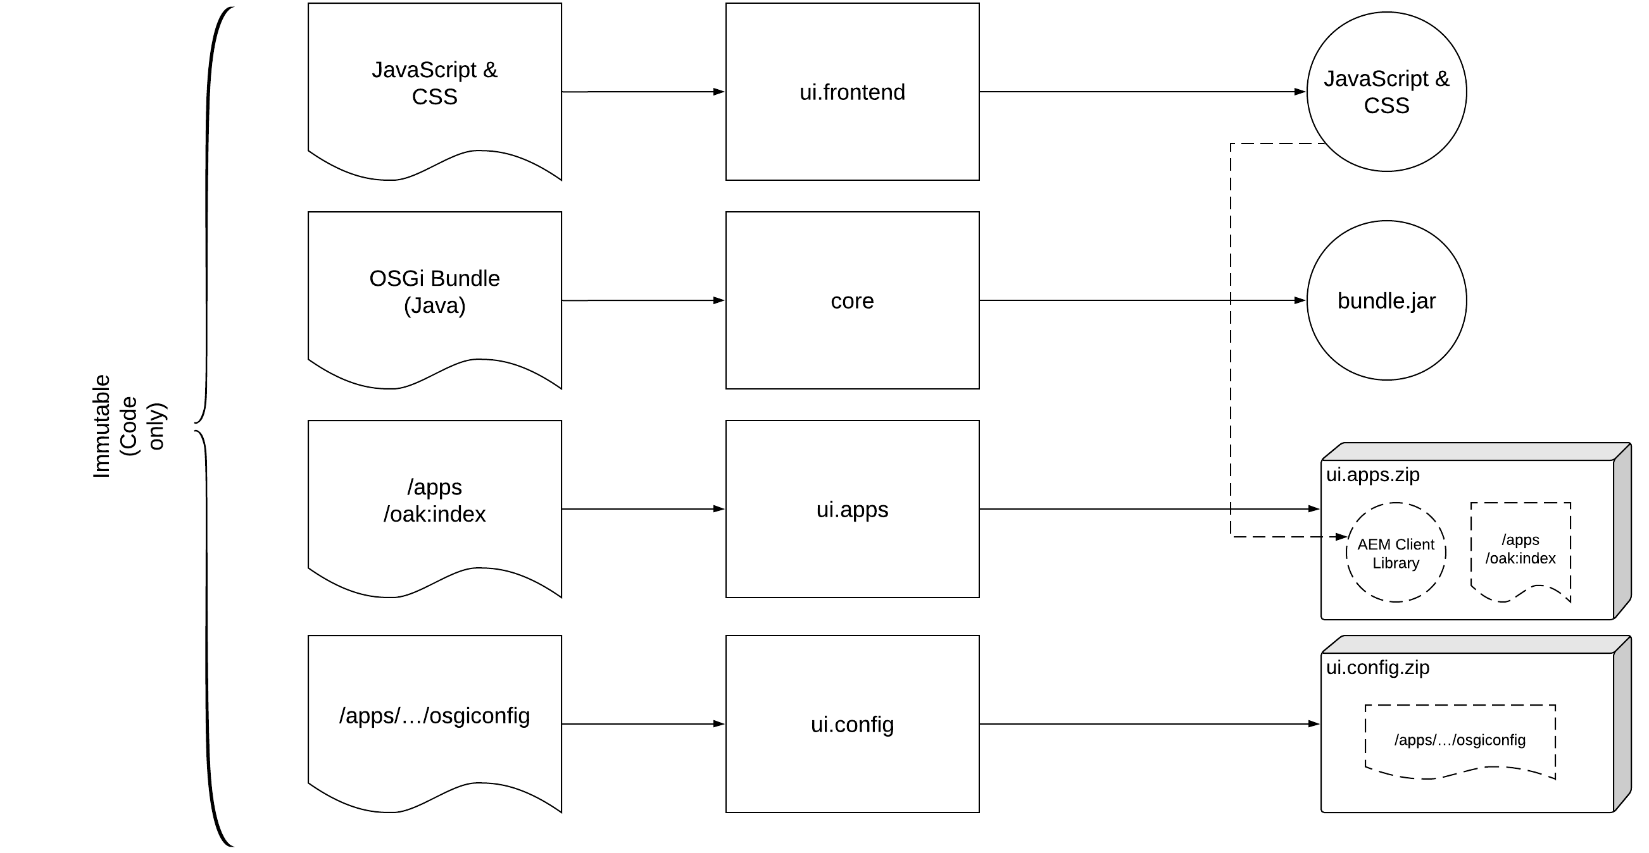
AEM Archetype | Immutable Modules
https://experienceleague.adobe.com/docs/experience-manager-cloud-service/assets/content-package-organization.png
92

Slide 93
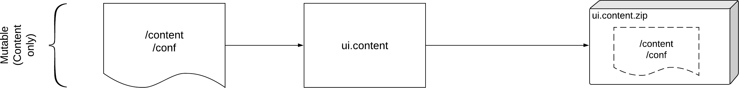
AEM Archetype | Mutable Modules
Mutable content in a project can be
Minimal content for the project to build
Initial templates and configurations
Skeleton site structure that components depend on
Initial folder structures for Experience Fragment and Assets
Initial Content Fragment Modules
https://experienceleague.adobe.com/docs/experience-manager-cloud-service/assets/content-package-organization.png
93

Slide 94
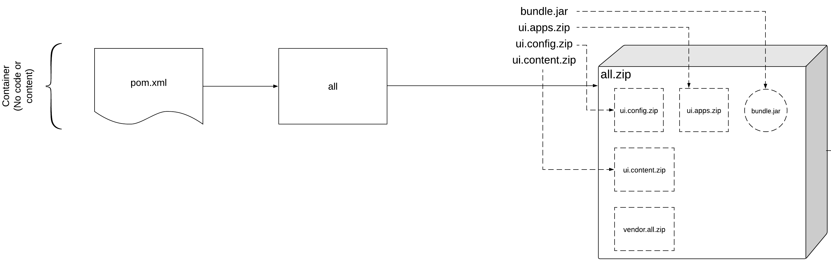
AEM Archetype | Container Module
Embed location for Immutable artifacts
/apps/example-packages/application/install/ui.config.zip
/apps/example-packages/application/install/ui.apps.zip
/apps/example-packages/application/install/bundle.jar
Embed location for Mutable artifacts
/apps/example-packages/content/install/ui.content.zip
Embed location for 3rd party artifacts
/apps/example-vendor- packages/container/install/vendor.all.zip
https://experienceleague.adobe.com/docs/experience-manager-cloud-service/assets/content-package-organization.png
94

Slide 95
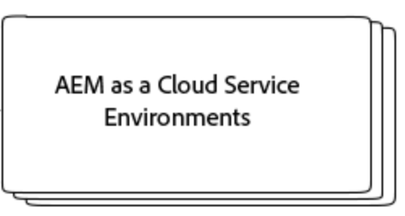
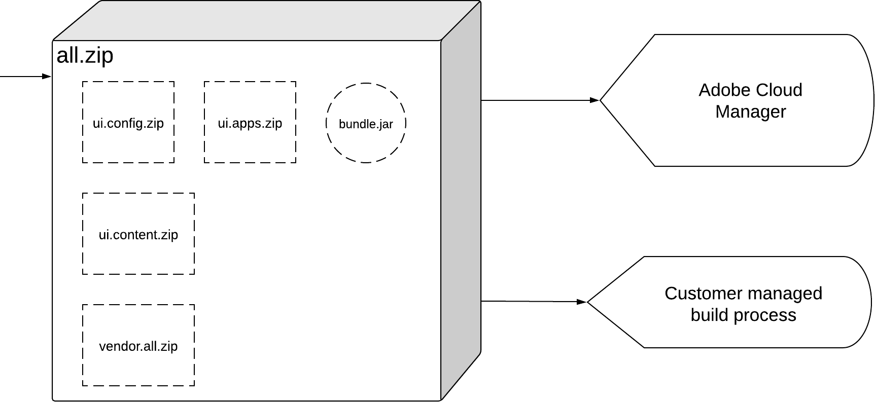
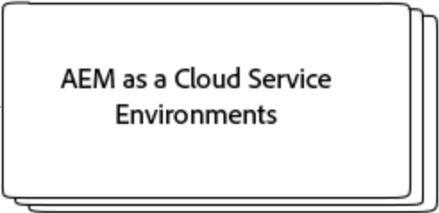
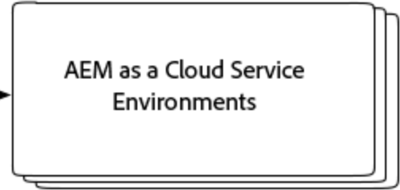
Build and Deploy | Dev, Stage, Prod Environments
AEM Managed Services Environments
On-Prem Environments
The all artifact a single container package that goes through the CICD pipeline within Cloud Manager
Cloud Manager then deploys the code to AEM environments
On-Prem deployments can also use the all container package

Slide 96

Build and Deploy | Local Development
Developer Profiles
Useful for targeted development
Defined in parent/pom.xml
$ mvn clean install -PautoInstallBundle
$ mvn clean install -PautoInstallPackage
Local AEM Instances
All Profile
Installs all project artifacts
Installs 3rd party artifacts
Defined in all/pom.xml
$ mvn clean install -PautoInstallSinglePackage

Slide 97
Other maven modules
ui.apps.structure
Defines the JCR repository roots this project uses
Ensures installation of packages are ordered by JCR resource dependencies
Generally, the default repository-structure module should handle most use cases in a project
it.tests
Container for sling testing on an AEM instance
it.launcher
Build it.tests with testing bundles into an AEM instance

Slide 98
Optional archetype inclusions
The archetype provides many different modules and configurations for a wide variety of AEM projects
React or Angular frontend module
Commerce Integration Framework (CIF) core components
AEM Forms add-on
Adobe Data layer
AMP support
Core components enabled with Dynamic Media
Example Core Component Library
https://github.com/adobe/aem-project-archetype#available-properties

Slide 99

Create a Project with Maven
Maven needs to be installed
Adobe’s nexus repo needs added to
username/.m2/settings.xml
Minimum number of params needed
Project can then be installed into AEM
$ mvn clean install –Padobe-public
-PautoInstallSinglePackage

Slide 100

Exercise 2: Synchronization tools for Eclipse
Tasks to perform:
Configure the profile for Maven
Create a project using Maven
Exercise
© 2021 Adobe. All Rights Reserved. Adobe Confidential.

Slide 101

Explore the POM files in the training project
training/pom.xml and observe
global properties
Dependencies, plugins, and profiles
training/all/pom.xml
Observe the embedded content packages
Observe the autoInstallSinglePackage profile
training/ui.apps.structure/pom.xml
Observe the typical content roots defined
Demonstration
© 2021 Adobe. All Rights Reserved. Adobe Confidential.

Slide 102
AEM’s Dependency Jar
Special JAR file provided by Adobe to reduce the number of dependencies Jar Contents:
All public Java APIs exposed by AEM.
Limited external libraries—all public APIs available in AEM that comes from Apache Sling, Apache Jackrabbit, Apache Lucene, Google Guava, and two libraries used for image processing.
Interfaces and classes exported by an OSGi bundle in AEM.
MANIFEST.MF file with the correct package export versions for all the exported packages.
Naming
AEM 6.5 – Uberjar API
Cloud Service - Java SDK API
102

Slide 103






Dependency Jar | Uberjar
AEM 6.5 and lower Only
AEM dependency is called the Uberjar
Use the same AEM version and service pack
Javadocs can be downloaded using
$ mvn dependency:resolve -Dclassifier=Javadoc
Dependency version should be updated based on:
Service Pack used
Example AEM 6.5.7 install
Maven Dependency element (parent)
Maven Dependency element (modules)
103

Slide 104





Dependency Jar | SDK API
Cloud Service Only
AEM dependency is called the Java SDK API
Use the same version as the AEM SDK downloaded
Javadocs can be downloaded using
$ mvn dependency:resolve -Dclassifier=javadoc
Optional download of deprecated APIs from 6.5
Artifact=aem-sdk-deprecated-6.5-api
Maven Dependency element (parent)
Example SDK Zip file
Maven Dependency element (modules)
104

Slide 105
Refresh AEM SDK | Quickstart and API
Cloud Service Only
Cloud Service runs on continuous releases
Daily maintenance releases will have minimal changes in the SDK
Monthly maintenance releases will typically have more impactful changes
Adobe recommends refreshing the SDK at least after a monthly maintenance release
When you download a new SDK, update your POM with the same release number
Optionally use same release as Production service
Can easily be found in Cloud Manager
105

Slide 106

Exercise 3: Install the project into AEM
Tasks to perform:
Update the POM file
Install the project into AEM
Verify the installed content packages
Exercise
© 2021 Adobe. All Rights Reserved. Adobe Confidential.
106

Slide 107
Maven
Open source development tool used to build and manage Java-based projects.
Configured using Project Object Model (POM) files.
AEM Archetype
Starter AEM project based on best practices
The archetype can be used for a wide variety of AEM projects
The All container package include all other artifacts
AEM dependencies are managed with the SDK API or Uberjar
Key takeaways
© 2021 Adobe. All Rights Reserved. Adobe Confidential.
107

Slide 108
Which maven modules are created as part of the AEM Archetype? Select three answers.
ui.apps.structure
code
ui.apps
ui.content
Knowledge check
© 2021 Adobe. All Rights Reserved. Adobe Confidential.
108

Slide 109
Developer Tools
Objectives:
Explain the features and UI elements of the AEM developer tools
Install a package in AEM
Create, build, and download packages
Describe AEM as a Cloud Service Project's content package structure
Create an immutable package
Create a mutable package

Slide 110

Development Consoles for AEM
Several consoles are available in AEM for development and administration:
CRXDE Lite
Web Console
Package Manager
Full access to these consoles is only available locally
Each console is limited or removed in shared environments
© 2021 Adobe. 2All Rights Reserved
2
ADOBE DIGITAL LEARNING SERVICES

Slide 111

CRXDE Lite
AEM > Tools > General > CRXDE Lite
Console for quick access to the JCR
Not recommended for full development
Create/edit nodes and properties
When to use CRXDE Lite:
Operations debugging
Overlays from /libs
Code/content validation
Product training
http://localhost:4502/crx/de
© 2021 Adobe. All Rights Reserved

Slide 112


Web Console
Consoles for Managing the OSGi container
Configuration – configurations for Java components
Bundles – manage all bundles in the OSGi container
Components – Java classes for
Status Consoles
Status output for everything
Other Consoles
JMX
Crypto support
HTTP Service
Many more tools…
http://localhost:4502/system/console
© 2021 Adobe. All Rights Reserved

Slide 113



Content Packages
Folder structure that contains JCR node and property data Content packages are zip files that contains two main parts:
jcr_root – subsets of the JCR tree as serialized nodes and properties
META-INF/vault/filter.xml - determines what to import/export with this package
Content package Uses:
A common standard for installation to the JCR
Maven build artifacts for an AEM project
Transfer content between Services
Hotfixes, feature packs, and service packs (6.5 and lower only)
© 2021 Adobe. All Rights Reserved

Slide 114


Package Manager
AEM Projects are installed via Package Manager AEM > Tools > Deployment > Packages
Upload and install content into AEM
Download content locally (.zip)
Replicate content packages to publish
Most actions available via cURL
http://localhost:4502/crx/packmgr/index.jsp
© 2021 Adobe. All Rights Reserved

Slide 115
Content Separation
Experience Manager requires a separation of content and code
Allows the cloud service to be auto-updated
Content is considered mutable
Mutable examples – configurations, pages, experience fragments, assets etc
/content, /conf, /home, /var are all considered runtime-writable
Code is considered immutable
Immutable examples – components, clientlibs, and so on
/apps – Customer immutable code
/libs – Adobe’s immutable code
Cloud Manager pipeline will fail if not separated properly
No separation validation on local quickstart
© 2021 Adobe. All Rights Reserved

Slide 116

Creating And Building New Packages
Create and build packages in your browser
Packages can be downloaded as *.zip files
Immutable package can only be installed locally
© 2021 Adobe. All Rights Reserved

Slide 117
Which tool can you use to create and build packages from your local author environment? Select one answer.
Web Console
CRXDE Lite
Package Manager
Package Share
Knowledge Check
© 2021 Adobe. All Rights Reserved. Adobe Confidential.
117

Slide 118
Exercise 1: Install a package
Exercise 2: Create, build, and download packages
Tasks to perform:
Create an immutable package
Create a mutable package
Exercise
© 2021 Adobe. All Rights Reserved. Adobe Confidential.
118

Slide 119
Development consoles available in AEM:
CRXDE Lite
AEM > Tools > General > CRXDE Lite
Web Console
o http://localhost:4502/system/console
Package Manager
AEM > Tools > Deployment > Packages
Key takeaways
© 2021 Adobe. All Rights Reserved. Adobe Confidential.
119

Slide 120
Developer Tools:
Bookmark/"favorite" these sites for a local author installation (development environment):
CRXDE Lite: http://localhost:4502/crx/de/index.jsp
Web Console: http://localhost:4502/system/console
Package Manager: http://localhost:4502/crx/packmgr/index.jsp
References
© 2021 Adobe. All Rights Reserved. Adobe Confidential.
120

Slide 121
Development with Visual Studio
Objectives:
Install Visual Studio Code
Describe Visual Studio Code Integrated Terminal
Describe VSCode AEM Sync
Install VSCode AEM Sync
Test VSCode AEM Sync Extension

Slide 122
Choose the right IDE
Integrated Development Environments (IDEs) are used to speed up development on projects Ultimately, it’s up to the developer and organization standards to choose
Common Java IDEs used for AEM development
Eclipse
Visual Studio Code
IntelliJ
Common Frontend IDEs for AEM development
Visual Studio Code
Brackets
Basic text editors (Notepadd++, bbedit, etc)
Depending on the project size and number of developers, it’s not uncommon to use many different IDEs among different teams and initiatives
122

Slide 123
Key AEM Development features
Common features an IDE should have for AEM development
Java Support
Node/NPM support
Maven
Junit test runner
Remote Java Debugging
Dependency management and autocomplete
AEM Project Sync
Nice to haves
JCR Properties view (.content.xml files)
Git support
123

Slide 124

Visual Studio Code
Lightweight and a powerful source code editor
Has built-in support for JavaScript, TypeScript, and Node.js
124

Slide 125

Visual Studio Code Installation
VS Code is a free editor
Runs on the following operating systems:
macOS
Linux
Windows
https://code.visualstudio.com
125

Slide 126
Exercise 1: Install Visual Studio Code (Local only)
ADLS Readytech environments already have Visual Studio Code installed
This exercise only needs completed if you are working locally
Exercise
© 2021 Adobe. All Rights Reserved. Adobe Confidential.
6
ADOBE DIGITAL LEARNING SERVICES

Slide 127


Maven Use | Options
Deploying an entire project or module requires Maven. Two common options
Maven command line outside Eclipse
VSC Integrated Terminal
Either option can be used in training

Slide 128

Visual Studio Code Integrated Terminal
Features of Integrated Terminal
Can be opened initially starting at the root of your workspace
Creates a separate window
Multiple terminals option

Slide 129

AEM Project Sync | Common Options
Export to AEM
Entire project or module
Maven command
M2Eclipse extension
Individual Files
Eclipse sync plugin
VSCode AEM sync
AEMFED command line
Repo command line
Import from AEM
Eclipse sync plugin
VSCode AEM sync
Repo command line
Vault command line

Slide 130
VSCode AEM Sync
Code and content synchronization
Pushes from a local Maven project to a local AEM
Only used for local development
Sync is one way. Maven project --> AEM
Benefits
There is no vault dependency.
Can push the content to multiple services at the same time
o For example: author and publish
Sync on file change(s)/save
Full status output of sync

Slide 131

VSCode AEM Sync | Installation
Works on Windows, Linux, and macOS
To install:
o Go to https://marketplace.visualstudio.com/items?itemName=yamato-ltd.vscode-aem-sync

Slide 132
Exercise 2: Install VSCode Sync (Local only)
ADLS Readytech environments already have Visual Studio Code installed
This exercise only needs completed if you are working locally
Exercise
© 2021 Adobe. All Rights Reserved. Adobe Confidential.
12
ADOBE DIGITAL LEARNING SERVICES

Slide 133



VSC AEM Sync | Configuration
Accept self-signed certs
Auto sync of saved files to AEM AEM Server info
User, password, and host
133

Slide 134



VSCode AEM Sync | Auto sync files on save
Make sure the extension is enabled
Auto-push is on
Make changes to the file(s)
Save the file(s)
Verify the changes in AEM
134

Slide 135

VSCode AEM Sync | Import from AEM
Make sure the extension is enabled
Auto-push is on
Import CRXDE Lite Activities
Dialogs structures reused
Overlay nodes from /libs
Import skeleton content back to the project
Pages, experience fragments, assets
Configurations
135

Slide 136
Exercise 3: Import an AEM Project into VS Code
Exercise 4: Synchronization tools for VSCode
Task 1 – Verify auto push is enabled Task 2 - Sync AEM Content
Exercise
© 2021 Adobe. All Rights Reserved. Adobe Confidential.

Slide 137
Key Takeaways:
Visual Studio Code
o Lightweight, powerful source code editor
VSCode AEMSync
Code and content synchronization for AEM
Pushes the content to AEM services upon a file change
Used for local development
Key takeaways
© 2021 Adobe. All Rights Reserved. Adobe Confidential.

Slide 138
Develop using Eclipse
Objectives:
Install and configure Eclipse
Install and configure the Eclipse AEM plugin
Import an AEM project in Eclipse
Sync AEM content

Slide 139
Choose the right IDE
Integrated Development Environments (IDEs) are used to speed up development on projects Ultimately, it’s up to the developer and organization standards to choose
Common Java IDEs used for AEM development
Eclipse
Visual Studio Code
IntelliJ
Common Frontend IDEs for AEM development
Visual Studio Code
Brackets
Basic text editors (Notepadd++, bbedit, etc)
Depending on the project size and number of developers, it’s not uncommon to use many different IDEs among different teams and initiatives
139

Slide 140
Key AEM Development features
Common features an IDE should have for AEM development
Java Support
Node/NPM support
Maven
Junit test runner
Remote Java Debugging
Dependency management and autocomplete
AEM Project Sync
Nice to haves
JCR Properties view (.content.xml files)
Git support
140

Slide 141

Eclipse IDE
Eclipse offers many benefits
Free and open source
Auto completion
Easy Code refactoring
Highly customizable to specific projects
Different perspectives depending on development activities
Error debugging
Supports many other languages beyond Java
Many framework integrations and plugins available
Benefits for AEM
m2e plugin for maven
AEM sync plugin
Git plugin
141

Slide 142
Exercise 1: Install and configure Eclipse (Local only)
ADLS Readytech environments already have Eclipse installed
This exercise only needs completed if you are working locally.
Exercise
© 2021 Adobe. All Rights Reserved. Adobe Confidential.
5
ADOBE DIGITAL LEARNING SERVICES

Slide 143

Eclipse | AEM Sync Plugin
Based on the Eclipse plug-in for Apache Sling. Benefits include:
Synchronization
Auto sync to AEM per saved file
Pull files from AEM
Supports debugging and code hot-swapping
Simple project wizard for AEM projects
View and edit xml files as JCR properties
Managed AEM server connection
© 2021 Adobe. 6All Rights Reserved
6
ADOBE DIGITAL LEARNING SERVICES

Slide 144

AEM Sync Plugin | AEM Perspective
Navigate to Window > Perspective > Open Perspective and select AEM.
JCR Property view with easy edit capabilities
Virtualizes content packages into a JCR view
Create Node option available based on common nodetypes
144

Slide 145


AEM Sync Plugin | JCR Properties View
AEM project store JCR properties in .content.xml files
Xml files can be viewed and edited in the JCR Properties panel Editing Supports
All property types
Value and value arrays
Auto sync on modification to AEM
145

Slide 146



AEM Sync Plugin | Virtual JCR view
To Enable right click on a content package maven module
Select Properties > AEM
Set the content sync root directory to the jcr_root folder
Typical Java Project
AEM Project with Virtual JCR
146

Slide 147
AEM Sync Plugin | Create a Node
147

Slide 148
Exercise 2 - Install and configure an Eclipse AEM plug-in (Local only)
ADLS Readytech environments already have Eclipse installed
This exercise only needs completed if you are working locally
Exercise
© 2021 Adobe. All Rights Reserved. Adobe Confidential.
11
ADOBE DIGITAL LEARNING SERVICES

Slide 149


Import a Maven project
In Eclipse, select File > Import from the menu.
Choose Existing Maven Projects in the Import wizard.
Browse and select the project you want to import.
© 2021 Adobe. All Rights Reserved
12
ADOBE DIGITAL LEARNING SERVICES

Slide 150
Exercise 3 - Import an AEM project in Eclipse
Exercise
© 2021 Adobe. All Rights Reserved. Adobe Confidential.
13
ADOBE DIGITAL LEARNING SERVICES

Slide 151

Maven Use | Options
Deploying an entire project or module requires Maven. Two common options
Maven command line outside Eclipse
Maven Plugin
For training purposes, maven command line will be used in training

Slide 152

M2Eclipse plugin
Features of M2Eclipse
Launch Maven builds from within Eclipse
Dependency management for Eclipse build path based on Maven's pom.xml
Resolve Maven dependencies from the Eclipse workspace without installing
Automatic downloading of the required dependencies from the remote Maven repositories
Quick search for dependencies in Maven remote repositories
For training purposes, maven command line will be used in class

Slide 153
AEM Project Sync | Common Options
Export to AEM
Entire project or module
Maven command
M2Eclipse extension
Individual Files
Eclipse sync plugin
VSCode sync extension
AEMFED command line
Repo command line
Import from AEM
Eclipse sync plugin
VSCode sync extension
Repo command line
Vault command line

Slide 154






Eclipse Sync Plugin | AEM Server
Server connection to an AEM server
Choose different modules in different projects to sync
Auto sync individual files to AEM on save
Manual sync from AEM
Start/stop/debug options

Slide 155






AEM Server | Configure Options
Change to AEM perspective In Eclipse
On the Servers tab, define the new server. Double click on the new server to configure
Port
Debug port
Username/password
Host
Timeouts
Auto publish rules

Slide 156


AEM Server | Filter rules
Filter rules determine what can sync with AEM
Applies to Maven
Applies to the AEM Sync plugin
Defined in filter.xml files within a module
src/main/content/META-INF/filter.xml
Example filter for ui.apps
Example filter for ui.content

Slide 157


AEM Server | Auto Sync Files on Save
Change to AEM perspective In Eclipse Make sure you are using virtual JCR view Make sure the AEM Server is started
AEM server connections are set to auto sync by default

Slide 158


AEM Server | Import from Server
Change to AEM perspective In Eclipse Make sure you are using virtual JCR view Make sure the AEM Server is started
Commonly used for CRXDE Lite Activities
Dialogs structures reused
Overlay nodes from /libs
Importing skeleton content back to the project
Pages, experience fragments, assets
Configurations

Slide 159

Exercise 4: Synchronization Tools for Eclipse
Tasks to perform:
Configure the AEM server
Sync AEM content
Exercise
© 2021 Adobe. All Rights Reserved. Adobe Confidential.
159

Slide 160

Which of the following tools are used to configure the AEM development environment? (Select the three correct answers.)
Maven
Eclipse
Apache Ant
AEM Plug-in for Eclipse
Knowledge Check
© 2021 Adobe. All Rights Reserved. Adobe Confidential.
160

Slide 161
Sites Authoring Basics
Objectives:
Navigate through the AEM UI
Create and edit pages
Explore core component authoring

Slide 162

Adobe Experience Manager User Interface
Based on Coral 3 and provides a foundational UI framework for:
UI widgets
Extensible and plug-in based admin UI
Adheres to:
Touch-Friendly
“Mobile first”
Extensible
Easy to override
Note: Coral 3 is Adobe’s universal UI across all products.
© 2021 Adobe. 2All Rights Reserved
2
ADOBE DIGITAL LEARNING SERVICES

Slide 163

AEM UI | Header Bar
The header bar is located on the top of the user interface with the following options:
© 2021 Adobe. All Rights Reserved
3
ADOBE DIGITAL LEARNING SERVICES

Slide 164

AEM UI | Navigation and Tools
Navigation
Displays all AEM applications available in the AEM UI
Tools
Displays all AEM administrative consoles, developer tools,
and other technical consoles available
© 20421 Adobe. All Rights Reserved
4
ADOBE DIGITAL LEARNING SERVICES

Slide 165



AEM Sites | Templates and Components
An AEM page is built with
A Template – determine the page structure, allowed components, styles, and layout
Components – modular units of code that allow user input
Styles – Predefined styles for users to choose on components
Responsive Tools – Emulators and component rules for breakpoints
+
=
© 2021 Adobe. 5All Rights Reserved
5
ADOBE DIGITAL LEARNING SERVICES

Slide 166

AEM Sites | Authoring Features
AEM pages provide a WYSIWYG UI for authoring
Drag and Drop Components
Set Responsive rules
Drag and Drop Assets
Add content to components
Add styles to components
Manage Publishing
Annotate
Edit Page Properties
And much more…
.
© 20621 Adobe. All Rights Reserved
6
ADOBE DIGITAL LEARNING SERVICES

Slide 167


AEM Sites | WKND Site
Reference implementation that illustrates the recommended best practices of AEM
Internationalized & Localized site structure
Responsive layout
Editable Templates
Core Components
HTML Template Language (HTL)
Content Fragments
Header/Footer Experience Fragments
Based on latest Archetype
AEM 6.4.8+, 6.5.4+, Cloud Service compliant
https://wknd.site
© 2021 Adobe. All Rights Reserved
7
ADOBE DIGITAL LEARNING SERVICES

Slide 168
Exercise 1: Create a page in AEM Exercise 2: Edit a page in AEM
In these exercises you will learn how to create pages in AEM and author them as an end user.
Exercise
© 2021 Adobe. All Rights Reserved. Adobe Confidential.
8
ADOBE DIGITAL LEARNING SERVICES

Slide 169
Core Components | Overview
Provides robust and extensible base components for AEM, built on the latest technology and best practices
Open Source
Production ready
Cloud Ready
Versatile and easy to use
Configurable
Trackable with the Adobe Data Layer
WCAG 2.0 accessible
SEO friendly
WebApp-Ready
AMP Support
Themeable
Customizable
Localizable
Headless/SPA ready
Dynamic Media ready
© 2021 Adobe. All Rights Reserved
9
ADOBE DIGITAL LEARNING SERVICES

Slide 170










Core Component Structure
Component Versioning
Dialog or Authoring UI clientlibs
Component clientlibs for design
Dialog for Content Policies or component configurations in the Template Editor
HTL script to render the component
Dialog for configuring the component instance on a page
Readme that is used in the Components Console
Feature for authoring actions that happed outside a dialog box
© 2021 Adobe. All Rights Reserved
10
ADOBE DIGITAL LEARNING SERVICES

Slide 171
Core Components | Authoring
As a Developer it’s important to understand the capabilities of the Core Components
Well integrated with the Page Editor
Feature-rich capabilities to accommodate many use cases
Pre-configurable (with Content Policies)
Built to support responsive layout
Developers can immediately start exploring core components with
Open Source Component Library
WKND site
An AEM project built from the latest Archetype
© 2021 Adobe. All Rights Reserved
11
ADOBE DIGITAL LEARNING SERVICES

Slide 172


Proxy Components
Core Components must not be directly referenced from the content (page)
Increased flexibility in releasing new versions
Customer chooses how often to update the referenced core component version
Site-specific components, known as ‘proxy components’ must be defined and implemented
Often proxy components contain no custom code and simply declare the relevant core component as a supertype
Use of proxy components supports future component customization without changing component references on the page
© 2021 Adobe. All Rights Reserved
12
ADOBE DIGITAL LEARNING SERVICES

Slide 173
Exercise 3: Explore core component authoring (Optional)
Even if this exercise is not complete during class, this is a good exercise to come back to after class and learn different ways to use core components.
Exercise
© 2021 Adobe. All Rights Reserved. Adobe Confidential.
13
ADOBE DIGITAL LEARNING SERVICES

Slide 174
Sites Authoring Basics:
https://docs.adobe.com/content/help/en/experience-manager- cloud-service/sites/authoring/getting-started/quick-start.html
WKND: https://experienceleague.adobe.com/docs/experience- manager-learn/getting-started-wknd-tutorial- develop/overview.html
https://experienceleague.adobe.com/docs/experience-manager- core-components/using/introduction.html
Core component library - https://github.com/adobe/aem-core- wcm-components
WNKD - https://github.com/adobe/aem-guides-wknd
Archetype - https://github.com/adobe/aem-project-archetype
References
© 2021 Adobe. All Rights Reserved. Adobe Confidential.
14
ADOBE DIGITAL LEARNING SERVICES

Slide 175
Using Brackets for development
Objectives:
Explain the features of Brackets
Install Brackets and the AEM Brackets Extension
Make changes to the repository by using Brackets

Slide 176

Brackets
Brackets is developed by Adobe and is an open source code editor for HTML, HTL, CSS, and JavaScript.
Features of Brackets
Live preview
In-line editors
Pre-processor support
A collection of add-on extensions
Available Plugins for AEM Developers:
AEM Brackets HTL Extension
JS, CSS, LESS, GIT & other (community provided)
Download Brackets for free at brackets.io
© 2021 Adobe. All Rights Reserved

Slide 177

Other IDEs and Text Editors
Maven
Export to AEM
$ mvn install
Vault (VLT)
Import from AEM
Based on filter.xml
$ vlt up
© 2021 Adobe. All Rights Reserved

Slide 178



Installing the AEM Brackets Extension
You can install the extension from
within Brackets, using the Extension Manager.
Features of AEM Brackets Extension:
o Automatic synchronization with the content repository
o Full content-package synchronization of the project
o HTL syntax highlighting
o HTL code completion
© 2021 Adobe. All Rights Reserved

Slide 179

Configuring Your Project
When you save your changes in Brackets, it is automatically synchronized to the AEM content repository.
o Indicated by a green icon in the toolbar on the right pane.
© 2021 Adobe. All Rights Reserved

Slide 180


Content Packages
Component Definitions
Java
JavaScript
Dialog Definitions
Content Package
Adobe Experience Manager
CSS
Misc UI Definitions
JCR
HTL
JSP
© 2021 Adobe. All Rights Reserved

Slide 181
Exercise 1 – Install Brackets and the AEM Brackets extension Exercise 2 – Make changes to the repository using Brackets
Exercise
© 20271 Adobe. All Rights Reserved. Adobe Confidential.
7
ADOBE DIGITAL LEARNING SERVICES

Slide 182
Run Modes: Overview
Run modes:
Are keywords Adobe uses to classify the AEM services
Can be used to meet specific environment needs
Are typically defined to include the service or tier and the environment
Tier run modes:
Author and publish run modes are mutually exclusive
Tier run modes are set at installation time and cannot be changed
Environment run modes: Dev, stage, prod

Slide 183





Viewing Current Run Modes Locally via Web Console
Access this URL directly on local AEM
http://localhost:4502/system/console/status-slingsettings
Note:
You can only access this console locally

Slide 184



Viewing Current Run Modes Locally via System Overview
Access this URL directly on local AEM
http://localhost:4502/libs/granite/operations/content/systemoverview.html
Note:
You can only access this console locally

Slide 185

Start Local AEM with Additional Run Mode
Start the local AEM instance:
java –jar aem-sdk-quickstart.jar -r author,dev -gui
Or modify the "/crx-quickstart/bin/start" script, then run the script.

Slide 186
Exercise 1: Run an AEM Service with the 'dev' Run Mode
To test code behavior on an AEM as a Cloud Service developer environment, you need to start the local AEM author and publish instances using the 'dev' run mode.

Slide 187









Run Modes Use Cases
Run modes can be part of the folder's name in JCR. This helps the AEM instance to:
Look up the right OSGi configuration
Install the right Content Package and OSGi bundle
OSGi bundles run modes are limited to the tier
supported formats for OSGi configuration run mode folders
supported formats for Content Package run mode folders

Slide 188







How Run Modes Are Applied
applied to all AEM instances
applied to all AEM author instances
applied to all AEM author,dev instances
applied to all AEM publish instances
applied to all AEM publish,dev instances

Slide 189








OSGi
Fundamental element in the technology stack of Adobe Experience Manager (AEM)
Small, reusable, and collaborative components are used
Bundles are built
into an application
Components are contained in
bundles

Slide 190




OSGi Service Configurations
Configuration files are created in AEM Maven project
Configurations are considered code
Enables configurations to be pushed into Cloud Manager
All AEM services will contain these configurations
Like code, OSGi configs can only be updated through a CI/CD pipeline

Slide 191


Determining Which Property Name and File Name to Use
From the Web Console > OSGi > Configurations
Find the desired configuration
Obtain the Property name and Node name-PID to use in your configuration node.

Slide 192


OSGi Configuration File Contents
/apps/<my-app>/config/com.day.cq.commons.servlets.RootMappingServlet.cfg.json

Slide 193



OSGi Configuration Values
inline values
{
“scheduledpurge.workflowStatus” : ”COMPLETED”, “scheduledpurge.modelIds” : [“publish_example”,
“request_for_deactiviation”],
“api-key” : ”$[secret:server-api-key]”,
“url” : “$[env:server-url]”
secret values
}
environment-specific values

Slide 194
OSGi Configuration Files for Factory Services
com.adobe.granite.workflow.purge.Scheduler~training.cfg.json
Persistent Identity (PID)
unique string for factory
config file
extension

Slide 195





OSGi Configuration Printer
OSGi > OSGi Installer Configuration Printer
serialization format

Slide 196
Exercise 2: Use the OSGi Installer Configuration Printer
In this exercise, you will use the OSGi installer configuration printer.

Slide 197

Environment-specific Configurations Using Run Mode

Slide 198
Multiple Configurations for the Same PID: Example
If an instance was started with:
-r author,dev
If the following configurations folder structure is defined:
/apps/*/config.author
com.day.cq.wcm.core.impl.VersionManagerImpl
/apps/*/config.author.dev
com.day.cq.wcm.core.impl.VersionManagerImpl
The config in /apps/*/config.author.dev will be applied.
This is because the config with the highest number of matching run modes is applied.

Slide 199
Common OSGi Configurations
Every OSGi service configuration is managed in the same manner
Some commonly used OSGi configurations:
Adobe Granite HTML Library Manager
Apache Sling Service User Mapper Service
Day CQ WCM Undo
Day CQ Root Mapping
Maintenance Tasks
Workflow Purge
Ad-hoc Task Purge
Project Purge

Slide 200






Deploying Configurations to Multiple Environments
Deploy to multiple AEM
instances
Capture the configuration information
Export it to change control

Slide 201
Exercise 3: Configure AEM with OSGi
Tasks to perform:
Create an OSGi configuration file in JSON format
Install and verify the configuration

Slide 202
Key Takeaways
Run modes enable you to define specific AEM behaviors for different types of AEM instances
OSGi Configuration definitions are stored in config folders matching the desired run mode
All configuration definitions are stored in the repository and activated by setting the appropriate run mode
If multiple configurations for the same PID are applicable, the configuration with the highest number of matching run modes is applied
How to check the run modes of any local instance
Common OSGi service configurations
22
© 2021 Adobe. All Rights Reserved Adobe Digital Learning Services22

Slide 203

Context-aware Configurations
Applications may need different configurations for:
Sites, regions, and tenants for different contexts
Are not system configurations
Support inheritance for nested contexts and global fallback values that are shared among different content resources
Context-aware configurations:

Slide 204

Context-aware Configurations
Help define and control the content subtrees to be the contexts in your application
Use Context-Aware Configuration Java API to match configurations for each content resource

Slide 205


Configuration Browser
Access context-aware configurations from the Configuration Browser console
Access the Configuration Browser from Tools > General panel

Slide 206
Configuration Browser
Current context-aware configurations are:
ContextHub segments
Cloud Configurations
Content Fragment Models
Editable Templates
Available context-aware permissions are:
Browse
Modify
Delete

Slide 207


Configuration Lookup Order
You can layer context-aware configuration across different folders:
/libs, /apps, /conf, and subfolders
under /conf
Adobe Experience Manager (AEM) configuration UI stores data in
/conf/global or /conf/<tenant>
If a configuration does not exit in
/conf/<tenant> AEM uses the fallback
locations

Slide 208
Exercise 1: Create a Configuration Folder (Uses ACME)
Adobe Experience Manager is designed to support multiple contexts. This allows for different configurations per site or brand. The DevOps project you create for this course comes with a prebuilt DevOps context.
In this exercise, you will create a new context to use for a new brand, ACME, that this project will support. Initially, the ACME brand needs to support Cloud Services as well as Editable templates. You will create a new context-aware configuration with the appropriate requirements.

Slide 209



Synchronize Configuration Folder with Your Project
When working locally with context-aware configurations:
Create configurations with the AEM UI
Configure or enable the functionalities appropriately
Synchronize configurations back to the Maven project
Commit the changes to Git
import from server

Slide 210




Import Configuration Folder into the Maven Project
Update ui.content > src/main/content/META-INF/vault > filter.xml
with the configs as needed:

Slide 211


Context-aware Configuration Example: Content Fragment Model
Content Fragment Models are the templates for structured Content Fragments
Use the editor UI to define Content Fragment Models
Tools > Assets > Content Fragment Model Editor

Slide 212


What Are Content Fragments?
Content Fragments are:
Small pieces of reusable content
Created from Content Fragment Model
Raw and unformatted
May have different variations
May contain a collection of assets through associated content: Images, documents, or movies
Minimal styling on text (rich text)
Bold and Italics
No layout, color, or size

Slide 213
Exercise 2: Enable Content Fragment Models for a Context
The Sites team has a requirement to start using Adobe Experience Manager as a central hub for content for their mobile applications and IOT devices. Their requirement is to query content using GraphQL, which requires structured content created by marketers and content creators. Adobe Experience Manager can use Content Fragment Models as templates for Content Fragments that can be queried by GraphQL.
In this exercise you will enable Content Fragment Models for the ACME brand and attach that context to an Assets folder for Content Fragments to be created.
Tasks to perform:
Add Content Fragment Models to a context (ACME)
Create a model in ACME
Create an asset folder for the context (ACME)

Slide 214





Global Configurations
Are configurations that apply to the entire AEM platform
Are used by these functionalities of AEM:
Translation Rules
Assets
Search Filters
Workflows
Maintenance

Slide 215


Assets Platform Configurations
Brand Portal
Dynamic Media
Adobe Stock
Integrate AEM Assets with the following solutions through configurations:
Tools > Cloud Services

Slide 216


Assets Platform Configurations
Asset Schemas
Asset Folder Schemas
Asset Profiles
Customize AEM Assets with the following global configurations:
Tools > Assets

Slide 217


Platform Search Filters
Tools > General > Search Forms
Use Search Forms to customize the selection of search predicates
Search Forms are used in search panels of AEM consoles
Customize the panels to make the search functionality versatile, according to your specific needs

Slide 218
Common Search Filters
Configuration |  | Description
Page Editor | Documents search | Defines document predicates in the authoring UI search rail
 | Image search | Defines image predicates in the authoring UI search rail
 | Page search | Defines page predicates in the authoring UI search rail
Sites Admin Search Rail |  | Defines site and page predicates of the Sites console search rail
Assets Admin Search Rail |  | Defines asset and folder predicates of the Assets console search rail
Project Admin Search Rail |  | Defines project predicates of the Project console search rail

Slide 219


Translation Rules in Configurations
Help identify content in AEM to be extracted for translation
Common use cases are:
Text components
Alt text for Image components
Define additional rules based on your project translation requirements
Tools > General > Translation Configuration

Slide 220

Workflow Configurations
New and modified workflow models and launchers are stored as global configurations
Out-of-the-box workflow models:
/libs/settings/workflow/models/
Modified OOTB and Custom workflow models:
/conf/global/settings/workflow/models/…
Tools > Workflow

Slide 221

Maintenance Configurations
Customers can configure, Ad-hoc Task Purge, Workflow Purge, and Project Purge tasks
Maintenance UI is not available in AEM Cloud and can only be accessed in local development
Maintenance changes must go through source control
Adobe manages maintenance tasks that do not require customer decisions; for example, Datastore Garbage Collection

Slide 222

Workflows
Formalize and support content management processes
Consist of sequential steps
Increase efficiency through:
Automation of steps
Coordination of steps and resources

Slide 223
Steps in Workflows
Author submits content to the workflow
A workflow is a sequence of steps.
Automated steps:
Automated steps
Manual steps
AEM performs the step automatically.
Trigger the next step of the workflow to be started.
Notification sent to the reviewer
Manual steps:
Review
Delegate
Notification sent to the reviewer
Send back
User or group is notified of the newly assigned steps.
Require a user to take an action.
Complete
Publish action initiates
Complete
Review

Slide 224


Managing Workflows: Workflow Console
Tools > Workflow
Administer the workflow capability:
Define and implement how a workflow works as a workflow model by using an editor
Monitor and manage the current and past workflow instances
Define triggers to start a workflow automatically

Slide 225


Workflow Tools
Process modeling
Models: Create and edit workflow models
Launchers: Start workflows automatically
Define triggers to start a workflow instance Process monitoring – DevOps focus
Instances: View instances of running processes
Archive: View finished workflow instances
Failures: View failed workflow instances

Slide 226




Workflow Steps
Participant step:
Enables you to assign a step to a user or group of users
Notifies participants of their required action through email
Helps configure timeouts and timeout handlers for this step
Process step: Executes JavaScript or calls an OSGi service (Java) to automate the process

Slide 227


Sample Workflow

Slide 228
Exercise 3: Work with a Workflow
As an administrator, you need to create a workflow model based on the requirements from the business.
Later, you will test the workflow to ensure that the desired functionality is met. You will install and observe a workflow model. This is a convenience for you to examine a completed model.
Tasks to perform:
Install a workflow
Observe a workflow model
Observe the model in the JCR

Slide 229








Start a Workflow for Content
Authors, Librarians, and general users can start workflows
Must be part of a workflow-users group
Create Menu (Assets and Sites)
Page Information Menu

Slide 230





Notification Inbox
View all steps, workitems, and notifications:
Assigned to the current user
Assigned to groups the user is a member of

Slide 231




Actions on an Inbox Item
To learn about the workflow, click:
Open, to display
Workitem info
Workflow info
⁃
Comments on workflow
Payload: Reveals the content attached

Slide 232




Actions on an Inbox Item
To continue the workflow, click:
Complete: Marks the item as completed
Step Back: Sends back to the previous participant
Delegate: Assigns the item to another user or group

Slide 233
Permissions
AEM permission groups for workflows
workflow-users can start workflows and participate
workflow-editors create/update workflow models
workflow-administrators have full control over all workflow consoles

Slide 234
Exercise 4: Execute a Workflow and Observe the Results
You have installed a workflow model content package and examined it within your local AEM service.
In this exercise, you will execute the workflow and observe it through Inbox, Instance, and Archive consoles.

Slide 235
Key Takeaways
Context-aware configurations:
Provide application support for different contexts and configurations within the same AEM instance
Are not system configurations
You can layer context-aware configuration across /libs, /apps, /conf, and subfolders under /conf folders
If you create configurations locally, synchronize the configurations back to your Maven project
Global configurations are applicable to the entire AEM platform
How to administer and monitor workflow

Slide 236

Maintaining the Repository Size
Node structures can increase the repository size massively—if not maintained
For example, Adobe Experience Manager (AEM):
Creates a new page version when it is published
Creates a new asset version when it is modified or published
Maintains a robust audit log of content changes including edits, moves, publication, and deletions
Stores a history of every workflow that is executed
Never removes ad-hoc tasks and projects completely from the system
These actions can add significant size to the repository if no mechanism is in place to remove the old nodes over a period of time

Slide 237
Manage Maintenance Tasks
Maintenance tasks are:
OSGi Configuration stored in /apps
Added to a single Maintenance window
Maintenance windows:
Are context aware config stored in /apps
Have a start and end date and time
If a task is not complete within the defined time, it continues in the next window
Can be set daily, weekly, or monthly

Slide 238


Maintenance Ownership
Tasks owned by Adobe: Datastore Garbage Collection
Tasks that have shared ownership:
Version Purge
Audit Log Purge
Task owned by the customer:
Ad-hoc Task Purge
Workflow Purge
Project Purge

Slide 239
Adobe Owned and Shared Tasks
Adobe Owned
Adobe owns the maintenance window and OSGi Configuration of the datastore garbage collection
Shared
Adobe owns the maintenance window
Customer owns the OSGi Configuration:
Version Purge
Audit Log Purge
Adobe owns the right to override these configurations to mitigate performance degradation

Slide 240
Customer Owned Tasks
Adjust maintenance window configurations
Add or remove tasks in each window
Configure running windows Can Modify OSGi configurations of:
Ad-hoc Task Purge
Workflow Purge
Project Purge
OSGi configurations must be stored in /apps/*/config folders

Slide 241
Maintenance Console
http://localhost:4502/libs/granite/operations/content/maintenance.html
Only available for local development
Changes must be checked into Git
Use the console to:
Adjust maintenance window
Add or remove tasks in window
Find OSGi configurations quickly
Console is a convenience for creating and configuring tasks
All new configurations must be added to Git under /apps/settings

Slide 242
Exercise 1: Run a Weekly Purge Task
Your organization is using workflows to manage page publishing.
By default, AEM workflows archive previously run workflows. This can be beneficial to go back and view the history of a workflow, but over time workflow history becomes less important and can be removed to reduce congestion in the workflows console and maintain the repository node size. The workflow maintenance task helps organizations run a periodic task to remove a defined set of archived workflows based on age.
In this exercise, you will manually run the weekly workflow purge task to test it.

Slide 243





Workflow Purge OSGi Configurations
Task configurations are stored as OSGi configurations
Find them easily from the Configure (gear) icon on the task
Use the Persistent Identity (PID) to create JSON config file OSGi configurations must be stored in /apps and checked into Git

Slide 244


Workflow Purge Configuration: Example
Workflow information can be purged based on:
Specific model IDs to purge:
Example ID:
/var/workflow/models/myWF
1-to-many model IDs
Blank: All workflows
Status: COMPLETED or RUNNING
Age of workflow (in days)

Slide 245
Exercise 2: Configure a Purge Task
In this exercise, you will configure a workflow purge task to purge the Custom Publish Workflow that you created in the Workflow module.
If you have not yet finished creating the Custom Publish Workflow in the Workflow module, you need to complete the exercise steps before you can do this exercise.
Tasks to perform:
Create a workflow purge OSGi configuration
Install and verify the configuration

Slide 246




Monthly Maintenance Windows
Must be manually created in JCR
Can be modified or configured from the Maintenance console
Can be scheduled:
On first or last day of month
At the day’s start and end time

Slide 247
Exercise 3: Create a Monthly Window
Your organization is using ad-hoc tasks. To ensure that older tasks are removed from the system, you want to create a monthly maintenance window to purge the tasks that are out of compliance by using the out-of-the-box ad-hoc task purge configuration.
This configuration purges the completed tasks that are older than 30 days and active tasks that are older than 90 days.

Slide 248

Maintenance Window: /conf vs. /apps
Maintenance UI adds maintenance windows and tasks under
/conf/global/settings/granite/operations/maintenance
After configuring, they must be checked into source control under
/apps/settings/granite/operations/maintenance
Allows the maintenance windows/tasks to be immutable

Slide 249




Sync the Configurations with Your Maven Project
Update ui.apps > /src/main/content/META-INF > filter.xml with the configurations as needed:

Slide 250
Exercise 4: Make Maintenance Windows Immutable
You have successfully configured the maintenance tasks locally using the Maintenance console. You now need to move these configurations into source control.
This will require the configurations to be moved to /apps, imported into the Maven project, and then checked into source control.

Slide 251
Key Takeaways
Maintenance tasks are processes that run on a schedule to optimize the repository
Use OSGi configurations to configure maintenance tasks specific to business requirements for purging content
Schedule the maintenance tasks to be executed during the daily, weekly, or monthly maintenance windows
Use the Maintenance console to configure the windows on a local AEM instance, synchronize them back into the AEM project, and check them into source control
Configure Adobe Granite Workflow Purge Configuration to purge workflow instances according their age and status

Slide 252

Access Control and Authorization for Profiles (Groups)
Access Control Authorization
Restricting access to a resource
Stored as a list of permissions granted or denied
Determining the action based on user access in specific areas within the system
Comparing the user’s identity against a list of permissions
Occurs within an AEM Service
252

Slide 253



Principals, Users, and Groups
A principal in AEM can be a user or a group
Users:
Are humans or an external system
Have accounts to store the details required to access AEM
Groups:
Are collections of users and other groups
Are used to simplify AEM permissions
Service Users: Are special users associated with OSGi services
253

Slide 254
Built-in Users in AEM
admin:
System administration account
Available only on Local AEM: admin/admin
Admin rights can be given by
Adding users to the administrators group within the AEM Service
Adding users to the AEM
Administrators-<UID> profile in the Admin Console
anonymous:
Has the default rights for unauthenticated access to an AEM service
Has minimum read access rights
Most often used on AEM Publish Service
254

Slide 255



Built-in Groups
Integration/Solution Specific
AEM Feature Specific
Platform Specific
Adobe Analytics
Adobe Target
AEM Forms
AEM Assets
AEM Sites Authoring
Projects
Page templates
Workflows
Experience Fragments
Tagging
Administrators
User Admins
Contributors (Read-only)
Example:
myUser is a member of myGroup
myGroup is a member of content-authors myGroup is a member of workflow-users
Note:
Use built-in groups as much as possible
This example gives myUser full access to build pages and run workflows
255

Slide 256


Service Security Console
Within AEM, the Security console can:
View synced users/groups
Create local users/groups (will not sync to the Admin Console)
Set granular permissions via Access Control Entry (ACE)
256

Slide 257
Permission Requirement in Custom Projects
content
Wknd/langmasters
/wknd..html
read modify
Create sub-pages
contributors
Workflow- users
Permission Console
content
Jcr:readAccessControl
Page properties
Jcr:modifyAccessControl
Site Authors
Site Managers
home
Jcr:read
cgrant
jbrown
content
Wknd
Page properties
All permissions
Exercise 3: Manage Permissions for Site Authors
Exercise 1: Create Permissioned Authoring Groups
Exercise 2: Manage Permissions for Site Managers
© ⁷2021 Adobe. All Rights Reserved
7
Adobe Digital Learning Services

Slide 258
Exercise 1: Create Permissioned Authoring Groups
In this exercise, as an administrator, you will create users and groups in AEM from the Security console. You will then add them to appropriate groups and verify access.
You will also give workflow user access to Site Authors. This will enable users to use workflows to request things such as publishing, deleting, and moving.
Tasks to perform:
Create new users and groups
Verify user access to WKND site
Add to default groups
Verify user access to workflow
258

Slide 259

Access Consoles for Content
Access is given based on the closest applicable permission up the content tree, if there is no local permission
259

Slide 260





Assigning Content Permissions
roughly equivalent to CRUD permissions
260

Slide 261
Permissions Beyond Built-in Groups and Consoles
Use built-in groups as much as possible for initial permissions
Use the Access consoles to allow non-technical users to manage access
Beyond the basics:
Use the Security console (Permission) to manage granular permissions
Access control is handled on the repository level (JCR)
All permissions are stored as nodes
261

Slide 262


Permissions Console
Accessed from Tools > Security > Permissions
262

Slide 263



Permissions Console
The tree in the left pane lists all the users and groups currently available in the system
The console includes all the paths in the repository
JCR Aactions and pPermissions
263

Slide 264
Access Control Entries (ACE) Node
Access control entries consist of:
Principals: A user or a group authorizable account
Subjects: The combined rights assigned to a user
Permissions/privileges
Access Control Lists (ACL): List of ACEs on that specific resource
264

Slide 265
ACE Privileges
The JCR has privileges that specify access for the principal user or group
jcr:read
jcr:modifyProperties
jcr:addChildNodes & jcr:removeChildNodes.
jcr:removeNode
jcr:readAccessControl
jcr:modifyAccessControl
crx:replicate
jcr:write
And more….
265

Slide 266
Permission Requirement in Custom Projects
content
Wknd/langmasters
/wknd..html
read modify
Create sub-pages
contributors
Workflow- users
Permission Console
content
Jcr:readAccessControl
Page properties
Jcr:modifyAccessControl
Site Authors
Site Managers
home
Jcr:read
cgrant
jbrown
content
Wknd
Page properties
All permissions
Exercise 3: Manage Permissions for Site Authors
Exercise 1: Create Permissioned Authoring Groups
Exercise 2: Manage Permissions for Site Managers
©¹⁶2021 Adobe. All Rights Reserved
16
Adobe Digital Learning Services

Slide 267
Exercise 2: Manage Permissions for Site Manager
In this exercise, you will give full access to site managers. You will also give Workflow user access to site authors. This will enable any member in the site managers group to perform self-service permission management for their team on the granted website locations in the next exercise.
Tasks to perform:
Provide site access to site managers
Provide self-service permissions
Verify access

Slide 268
Exercise 3: Manage Permissions for Site Authors
In this exercise, you will sign in as a member of the site managers group to perform self-service permission management for your team on the granted website locations. This will help reduce the amount of detailed website branch permission configurations from administrators.
Tasks to perform:
Provide site permissions using a site manager
Author a page as a site author user

Slide 269
Access Rights Precedence
ACEs in the JCR follow these ordered rules:
Check for local access rights on the node.
If there are none, the JCR picks the nearest ancestor whose ACE applies.
If the node has an ACE about the user it is used, and any group statements are ignored.
As a good practice:
Do not assign access rights directly to users, only to groups
Use Deny clauses sparingly
For the bulk of ACEs, use only Allow statements

Slide 270

Example
A Principal is a user or a group
A Group might contain other principals
A Subject is a union of all access rights granted directly to the principal and all access rights granted through group membership

Slide 271
Authorizables
Authorizables can be managed from:
Adobe IMS
Manually from the Admin console
Externally from an external IDP
Manually in the AEM Service (not synced back to Adobe IMS)
Via code for repeatability: Can be useful for organizational groups and auto-membership of users
Via UI for a single service: Can be useful for testing ACEs and groups

Slide 272

Service Users and Permissions
Service users:
Are created by developers to allow their codes to access JCR
Are configured via “Apache Sling Service User Mapper Service Amendment”
Permissions are set by DevOps on Production
To restrict the code’s power
Same as the permission configuration for normal user / group

Slide 273
Repository Initialization: Another Way to Manage User, Group, and Permissions
Some elements of an application need to be loaded first to install the application successfully
Create/delete/disable service users
Create/delete users and groups
Add access control lists (ACLs)
Add path (for example, for root folder structures)
Add CNDs (nodetype definitions)
Add repository namespaces

Slide 274
Repository Initialization: Another Way to Manage User, Group, and Permissions
SlingRepositoryInitializer runs the code before the SlingRepository service is registered
Enables initialization
Controlled by use of repoinit script
Useful for initialization and content migration purposes

Slide 275








Repository Initialization Language (Repoinit)
Example language

Slide 276
Repoinit vs. Mutable Content Package
repoinit | Mutable Content Package
Creates resources at startup | Resources are created after startup
Safe instruction set: With few exceptions, supported operations are additive | Removal of something is explicit
Fast and atomic operations | Performance highly dependent on the structures covered by a filter
During application deployment, repoinit statements are executed independently of the installation of any content packages

Slide 277






Repoinit Configuration

Slide 278




Caution: Syntax

Slide 279
Exercise 4: Define Service User Using Repoinit
A developer is implementing a background service that requires authentication and authorization to write to the repository. A service user is necessary to authenticate the service to the repository and to create a permission context within which the service will run. In addition, the service user needs to be granted the appropriate permissions.
Tasks to perform:
Define the repoinit OSGi configuration file in JSON format
Install and verify the configuration

Slide 280
Users, Groups, and Permissions: Best Practices
Avoid assigning access rights on a user-by-user basis
Use Allow statements wherever possible
Use the AEM UI to edit permissions and not CRXDE Lite
Invest time when configuring users and groups on a new installation
Use a test installation to verify and understand the relationships between various users and groups
Update the default users and groups immediately after installation to help prevent any security issues

Slide 281

Cloud Manager for Adobe Experience Manager (AEM)
Self-service Portal
Easily access & manage the cloud environment and CI/CD pipeline
CI/CD Pipeline
Code inspection, performance testing, and security validation
Flexible Deployments
Schedule code deployments during specified time frames
Autoscaling
Detects the need for additional capacity during unexpected spikes

Slide 282



Autoscaling in Action
P
D
P D
P D
P
D
P
D
P
D
Existing Publisher- Dispatcher Tiers
Load Spike
Autoscaling Event Triggered
New Tiers Added via Cloud Manager Autoscaling

Slide 283




Cloud Manager Entities
AEM Cloud Manager
Single entry point for the Operations & Developer personas to create and manage components of Adobe Experience Manager as a Cloud Service
Programs
Environments
Pipelines
Self-service creation of AEM applications (AEM Sites, AEM Assets) with associated code repository
Self-service creation of AEM environments (production and non-production – for example, demos, POC, training…)
Self-service creation of CI/CD pipelines for best practices

Slide 284
Cloud Manager Terminology
AEM Author Tier | Describes the authoring environments for Sites and Assets
AEM Publish Tier | Describes the publishing environments for Sites
Adobe Pipeline | Mechanism for publishing content from author to publish
Asset Microservices | Cloud-based digital asset processing service
AEM Image | Artifact that contains the AEM product code and customer code
Git Repository | Location where customer code is stored

Slide 285

Hierarchy of Entities in Cloud Manager
Adobe Experience Cloud organization
Cloud Manager
Adobe Experience Cloud Core Services
Admin Console
Launch
Adobe Experience Platform
Program 2
Program 3
Program 4
Code Repository
Branch 1
Branch 2
Branch …
Programs manage and provide all the necessary tools for a single AEM application
Tools for Self-service
Developer Console Access
Access Environments
Add and Manage Environments
Configure and Deploy Pipelines
Manage Git
Download Logs

Slide 286




Program Creation
Based on licensing, you might set up your own Programs
Sandbox programs
Full functionality programs with reduced
cloud resources.
Useful for POCs, demos, product training, and other non-production exploration
Production programs
Fully functioning programs with limitless resources and scalability

Slide 287


Program Solutions and Add-ons
Based on your contract, you may be able to edit the types of solutions and add-ons that are enabled in a Program
A deployment pipeline per environment needs to run to enable the solution or add-on
Current Solutions
Sites, Assets, and Forms
Current Add-ons
Commerce and XML Documentation

Slide 288
Exercise 1: Log In to a Training Program
When working with AEM as a Cloud Service you will need to access Cloud Manager to gain access to the author/publish URLs, run pipelines to install your custom code, and manage your AEM Services.
In this exercise you will log in to the training organization and access a program. This is the initial setup for future modules in this course.

Slide 289





Hierarchy of Entities in Cloud Manager
Adobe Experience Cloud organization
Cloud Manager
Adobe Experience Cloud Core Services
Admin Console
Launch
Adobe Experience Platform
Program 1
Program 2
Program 3
Program 4
Code Repository
Branch 1
Branch 2
Branch …
Environments provide cloud native services to deploy your application
Tools for Self service
Developer Console Access
Access Environments
Add and Manage Environments
Configure and Deploy Pipelines
Manage Git
Download Logs

Slide 290
Exercise 2: Create a Development Environment
You may want to create a development environment for developers and a build pipeline connected with Adobe Cloud Manager to streamline development activities.
In this exercise, you add a development environment.
Important: You are creating the environment now because it takes approximately 5-15 minutes to create. You will learn more about Environments later in the course.

Slide 291
Adobe Identity Management System (IMS)
An authentication service for all Adobe products
Can be configured with a customer’s
SSO
LDAP
Other identity providers (IDP)
AEM IMS service accounts are tightly integrated with
Adobe Launch
Adobe Target
Adobe Stock
Any Adobe I/O connection

Slide 292

IMS Architecture

Slide 293
IMS IDs
Three types of identities of accounts to authenticate and authorize users:
Federated ID
Enterprise ID
Adobe ID
The Enterprise and Federated ID models are an ideal choice for enterprises The Adobe ID is best suited for individuals

Slide 294


IMS for AEM Authentication
Customer onboarding to the Admin console is a prerequisite
Must have an IMS organization provisioned by Adobe
Joint effort between Adobe and customers
Supports local and IMS authentication

Slide 295
Admin Console
Admin Console manages all users and groups in Adobe Experience Cloud
Users can be added to product profiles in the Admin Console
Product profiles give access to Cloud Manager, AEMaaCS, and other Adobe products
Administrators use the Adobe Admin Console to:
Create, import, and manage user accounts
Assign users to different Adobe products
Add users to product profiles (groups) to manage higher level products permissions

Slide 296

Understanding Different Admin Roles in Cloud
System Admin
Federated ID
Enterprise ID
Adobe ID
AEM Product Admin
Add users to Cloud Manager
Add users to AEM Services
Works in AEM
Create new product profiles for group membership
AEM Admin
Manages AEM group permissions (within AEM)
Works in the Admin Console

Slide 297

Terminologies in the Admin Console
Products
Target, Analytics, Audience Manager (products)
Adobe Experience Manager as a Cloud Service (product) Product Profiles
Used to control the access for products
Control access to Cloud Manager
Add IMS users to profiles for Cloud Service. Profiles sync as AEM groups Users
Individual user can access different products in Cloud
Typically coming from IMS or external ID services

Slide 298




AEM Terminology in the Admin Console
Instances
Exist under the Adobe Experience Manager as a Cloud Service product
Dev, stage, prod service instances to manage access
Naming: <programName>-<envName>-[author | publish] (instance)
Special instance for Cloud Manager access: https://my.cloudmanager.adobe.com/<UID>
instances = AEM Services
cloudmanager instance = Governs Cloud Manager

Slide 299



AEM Product Profiles in the Admin Console
Product Profiles control two levels of access for Experience Manager
Cloud Manager product profiles give specific access to managing programs and other privileges within a program
Service profiles manage access to the AEM service for IMS users
Admin Console Governance
Cloud Manager
Program n
Prod environment
Author service
Publish service
Program 1
Program 2
Stage environment
Author service
Publish service
Program 3
Dev environment
Author service
Publish service

Slide 300


AEM Service Product Profiles
AEMaaCS (Product)
AEM Service (Instance)
AEM Users-<UID> (profile)
AEM Administrators-<UID> (profile)
<custom profiles> (profile)
AEM Profiles sync as AEM groups
Via “Adobe Granite OAuth IMS Provider”
ims.group.mapping property
Group’s permission is managed within the AEM Service
instances = AEM Services
cloudmanager instance = Governs Cloud Manager

Slide 301







Quick Access to Service Product Profiles
Only available for users added to the Business Owner product profile for Cloud Manager
Training user accounts have Deployment Manager access only and will not see this menu item

Slide 302


Cloud Manager Profiles
Cloud Manager & Profiles (Product)
https://my.cloudmanager.adobe.com/<UID> Each profile is outlined on helpx. In general:
Business Owner: Full control
Deployment Manager: Manages pipelines
Developer: Access to Git/pipelines
Integrations: For services
Program Manager: Mainly read and some execution permissions
instances = AEM Services
cloudmanager instance = Governs Cloud Manager

Slide 303
Demonstration
Admin Console and Product Profiles

Slide 304

Hierarchy of Entities in Cloud Manager
Adobe Experience Cloud organization
Cloud Manager
Adobe Experience Cloud Core Services
Admin Console
Launch
Adobe Experience Platform
Program 1
Program 2
Program 3
Program 4
Code Repository
Branch 1
Branch 2
Branch …
Environments
Pipelines install your application code onto environments
Prod
Stage
Dev 1
Dev x
…
Tools for Self-service
Developer Console Access
Access Environments
Add and Manage Environments
Configure and Deploy Pipelines
Manage Git
Download Logs

Slide 305
Exercise 3: Create and Build a Deployment Pipeline
Depending on the build process, Cloud Manager offers a wide variety of pipeline configurations to start the pipeline manually or automatically.
In this exercise, you will create and build a Deployment Pipeline.
Important: Deployment of pipelines can take 50–60 minutes to be created. During that time, we will be learning about other topics but will dive deeper into pipelines in a later module.

Slide 306
Key Takeaways
Cloud Manager UI
Cloud Manager benefits
Cloud Manager entities
Program
Environment
Pipeline
Admin Console and IMS
Products and profiles

Slide 307


Deleting Environments
Development Environments
Can be deleted
Allows for 1 to many dev environments
Best practice to delete unused environments
Stage/Prod Environments
Can be deleted
Allows for 0-1 stage/production environment per Program

Slide 308



Recycling Environments
Depending on how you are using a Development environment, you can:
Update an environment
Updates the build in Development pipeline – this pipeline needs to run to perform the update
Updates to the latest AEM build
Useful for retesting the same Git branch
Useful to keep testing content Delete an environment
Allows new/clean env to be created
Frees up resources and reduces clutter

Slide 309
Exercise 1: Remove the Dev Environment
Unlike Stage/Prod environments, Dev environments are not auto-updated with the latest AEM builds. As a developer, you have the option to manually update the environment as needed through a pipeline update.
If you are not planning to use the environment going forward, it is useful to delete the environment to free up resources. In this exercise you will delete your dev environment because you will no longer be using it in this course.

Slide 310


Remove Unused Pipelines
Non-production Pipelines
Many can be used in parallel
1 Deployment Pipeline per Dev environment
0 to many Code Quality Pipelines
Can quickly clutter up the pipeline console
Should be deleted after…
Development environment is deleted
Code Quality tests are not needed

Slide 311
Remove Unused Pipelines
Production Pipelines
Can only have 1
Cannot be deleted

Slide 312
Exercise 2: Remove Unused Pipelines
In a Program you can have as many pipelines created and executing as you prefer. This allows for many Code Quality Pipelines to be running in parallel with actual dev/stage/prod pipelines.
Unfortunately, Code Quality Pipelines can quickly clutter your pipeline console, so it makes sense to remove them if you are no longer using them. In this exercise you will remove all pipelines you created because you will no longer be using them for this class.

Slide 313
Knowledge Check
Which of the following three are true about Non-production Pipelines? Select three correct answers.
Can be deleted
Cannot be deleted
Many can be used in parallel
Code Quality tests are not needed

Slide 314
Key Takeaways
Development Environments can be deleted without Adobe Support
Stage/Prod Environments cannot be deleted without Adobe Support
Best practice: Remove unused Pipelines and Environments
Production Pipelines cannot be deleted

Slide 315
What You’ve Learned
You should now be able to:
Perform Cloud Manager basics
Work with programs and environments
Use the Cloud Manager Git
Create mutable and immutable packages
Configure Non-production and Production Pipelines
Run code quality tests
Configure the dispatcher for Cloud Service
Manage publishing

Slide 316






Cloud Manager Environments
Accessed from Program Overview and Environments pages of Cloud Manager
Environments
Program Overview

Slide 317
Cloud Manager Environments
 | Programs can have different types of environments:
1 to many development environments (based on licensing) 0 to 1 stage + prod environment pairs
 | An environment consists of:
An author service Zero to one publish services (based on licensing) If there is a publish service: Publish is accessed through a Dispatcher and CDN A Preview Service is available

Slide 318




Environments
Environments
Environments consist of: Author, Preview Publish, Publish, Dispatcher, CDN
Preview Publish Service (since August 2021): An exact copy of the Publish Service to optionally send content for preview
Environments are autoconfigured with:
Stage + Prod
Prod Author
git code
Prod Preview
Publish
Dispatcher
git co
de
Adobe CDN
Replication
Cloud native microservices
Sensei features like Smart Tag and Smart Crop
Adobe IMS for authentication
Prod Publish
Publish
Dispatcher
git co
de
Stage
Author
Dev 1
Author, Preview, Publish
Dev x…

Slide 319
Environment Types
Production and Stage
Development
Available as a duo
Used for development and testing
Used for testing and production
Associated with non-production pipelines

Slide 320
Capabilities of Environments
Capability | Local | AEM as a Cloud Service
 | SDK Quickstart | Dev Author | Stage, Prod Author | Dev, Stage, Prod Publish
Admin User | Yes (admin/admin) | No
CRXDE Lite | Yes | Yes: limited | No
Publishing Content | Manually configured replication agents | Sling Distribution Agents are autoconfigured |  | No
Package Manager UI | Yes | Yes: mutable content only |  | No
Asset Processing | DAM Update Workflow | Asset Compute |  | None
SSL Configuration | Manual through UI | Autoconfigured
Classic configuration consoles exist in the local SDK quickstart only. Make sure to add these configurations to ui.apps to load onto Cloud Service through CI/CD
Author UI Developer Mode is only available on the local SDK quickstart

Slide 321





Available Key Operations for Environments
Action | Description
View Details | View and access the Author, Publish, and Dispatcher services
Download Logs | Access a list of available log files for the environment
Update | Updates the associated deployment pipeline to the latest build
Developer Console | Generates system status, resolves package dependencies, and is used for debugging
Manage Access | Access product profiles associated with this environment
De-hibernate | Wake up a hibernated environment
Delete | Delete an environment
Local Login | Log in to an author service with a local login rather than IMS
Note:
Some actions above may not show up because they can be based on the Cloud Manager access rights, program type, and environment type

Slide 322
Exercise 1: Access Author and Publish Services
Task 1: (Optional) De-hibernate
Task 2: Access the Publish Service Task 3: Access the Author Service

Slide 323
AEM Logging
Critical function to debug and understand code execution
Categorized into two logical sets:
AEM logging, which performs logging at the AEM application level
Apache HTTPD Web Server/Dispatcher logging, which performs logging of the web server and Dispatcher on the Publish tier

Slide 324





Access Logs
List of available log files for the selected environment from the Environment page

Slide 325
Log Types
Source | Cloud Log | Local Log | Definition
AEM | aemerror.log | error.log | Error log for AEM
AEM | aemaccess.log | access.log | HTTP access request to the AEM service
AEM | aemrequest.log | request.log | HTTP request or response of AEM service
Apache log | aemdispatcher.log | dispatcher.log | Dispatcher log for requests, caching, and filtering
Apache log | httpdaccess.log | access.log | HTTP requests to the Apache server
Apache log | httpderror.log | error.log | Error log for Apache

Slide 326
Log Format
Date and Time | AEM as a Cloud Service Pod ID | Log Level | Thread | Java Class | Log Message
29.04.2020 21:50:13.398 | [cm-p1234- e5678-aem- author- 59555cb5b8- q7l9s] | *DEBUG* | qtp213057203 6-1472 | com.example. approval.work flow.impl.Cust omApproval Workflow | No specified approver, defaulting to [Creative Approvers user group]

Slide 327
Exercise 2: Download Logs
Your organization is using AEM as a Cloud Service for their marketing website.
As an administrator, you will log in to Cloud Manager and observe different environments associated with the program.
You will observe the server logs available on the author service and download today's aemerror.log to your machine.

Slide 328




Developer Console
Accessed from the drop-down menu in the Environments page of Cloud Manager
Note:
IMS users need to be added to the Cloud Manager Developer product profile (at minimum) to access the developer console

Slide 329



Developer Console
Access information provided by the OSGi web console in text or JSON format: Status dumps of bundles, components, configurations, Oak indexes, OSGi services, and Sling jobs
Check Java Package resolution
Test servlets on running on environments
Access the Query Tool on Author Service
Quick access to integration tokens for Adobe IO
De-hibernate environments

Slide 330
Exercise 3: Access and Explore the Developer Console
In this exercise, you will access the Developer Console and explore the console.

Slide 331
Content Separation: Review
Experience Manager requires a separation of content and code
Content packages cannot mix mutable (content) and immutable (code) content
Immutable Content – (/apps) components and clientlibs
Mutable Content – (/content, /conf) configurations, pages, and assets
Adobe – (/libs) AEM product code
Mixed content packages fail the CI/CD pipeline
Allows Cloud Service environments to be updated with zero downtime

Slide 332

Cloud Manager and Content Packages
Cloud Manager builds project code into content package artifacts for deployment
Content Package
Cloud Manager transforms immutable content packages into a cloud safe artifact called a Sling Feature Model
Sling Feature Model
Mutable content packages are not transformed and are installed in real time after the Sling Feature Model artifacts

Slide 333
Content Package to Feature Model Converter (cp2fm)
Transforms locally assembled content packages into an artifact conforming to the Sling Feature Model, which is how a Cloud Service application is described when running in a cloud environment
Extract OSGi bundles, OSGi configurations, resources
Iteratively scan nested content packages from an input content package
Create one or more Sling Feature Model files
Deploy the extracted OSGi bundles in a directory structure compliant with Maven repository conventions

Slide 334


Package Manager for Cloud Service
Package Manager is available on all Author Services (dev, stage, prod) at a limited capacity
Immutable content packages cannot be installed and are appended with –cp2fm-converted.zip
Mutable content packages can be uploaded and installed in real time
Mixed content packages cannot be installed

Slide 335
Exercise 4: Install Mutable and Immutable Content Packages
You can verify whether you can upload immutable content using the Package Manager.
Task 1: Observe and install mutable content package Task 2: Observe and install immutable content package

Slide 336


Cloud Manager API
Allows access to Cloud Manager programs, pipelines, and environments by an authorized technical account
Allows for integration of the Cloud Manager CI/CD pipeline with other systems
Composed of two components:
An inbound HTTP-based API that reads and manipulates the state of CI/CD pipelines
An outbound event system that receives events when key events happen in CI/CD pipelines

Slide 337


Adobe I/O
Adobe developers' portal
Serverless platform
Integrates and extends Adobe’s cloud platform
Allows secure access to Adobe’s APIs
Allows responses to events across the platform

Slide 338


Adobe I/O CLI (aio) with Cloud Manager
Provides command-line access to a variety of Adobe services
Provides developers the ability to:
Tail logs
Create environment variables
Create/delete/progress/view Cloud Manager pipelines
Create/delete/view Cloud Manager environments
Manage IP allow lists
Switch between Organizations and Programs Dependencies
Node 12.x or 14.x installed (for npm)

Slide 339


Install and Authenticate
Installation
$ npm install -g @adobe/aio-cli
$ aio plugins:install @adobe/aio-cli-plugin-cloudmanager
Authentication
$ aio auth:login
$ aio cloudmanager:org:select
AIO authenticates using Adobe’s two-step verification through a web browser
Once authenticated, select your Adobe Organization through an interactive terminal menu
Detailed steps can be found at the github project: https://github.com/adobe/aio-cli-plugin-cloudmanager

Slide 340
Example aio Command
$ aio cloudmanager:environment:tail-log ENVIRONMENTID SERVICE NAME
Arguments
ENVIRONMENTID: Environment ID
SERVICE: The service
NAME: The log name
Options
-p, --programId=programId: The programId. If not specified, defaults to 'cloudmanager_programid' config value
--imsContextName=imsContextName: Alternate IMS context name to use instead of
aio-cli-plugin-cloudmanager
To see more example commands, view the github project: https://github.com/adobe/aio-cli-plugin-cloudmanager

Slide 341


Demonstration
Tail the Logs Using aio-cli Cloud Manager Plugin
Environment > … > Download Logs

Slide 342



Custom Domain and DNS
Cloud Manager allows you to add a custom domain to identify your site with a unique, branded name
in a self-service manner
Adding custom domain name
Adding TXT record for CDN
Checking custom domain name status
Configuring DNS settings
Checking DNS record status
Updating or deleting custom domain name

Slide 343
Key Takeaways
The Cloud Manager AEM environment consists of an author service and zero or more publish services
Logging is a critical function for debugging and understanding code execution on local and cloud development environments
The Developer Console provides access to developer tools available in local installs
cp2fm transforms locally assembled content packages into an artifact conforming to the Sling Feature Model
Content packages cannot mix mutable and immutable content
Cloud Manager API and aio-cli Cloud Manager plugin allow integration and automation

Slide 344
Cloud Manager Pipelines
Enables implementation teams to quickly test and deploy the project code
Comprehensive test results and logs
Two types
Automated testing
Provide details on what’s going wrong and
how to fix
Increase deployment efficiency
Non-production Pipeline
Visibility into potential impact on Key Performance
Identify critical issues before go live
Production Pipeline
© 2021 Adobe. All Rights Reserved
2
Adobe Digital Learning Services

Slide 345
Non-production Pipelines

Slide 346
Non-production Pipeline Types
Code validation
Maven build & unit testing
Code scanning using SonarQube
Building Author/Publish/Dispatcher images
Code Quality Pipeline
Code Quality Pipeline
Deployment Pipeline
Deploy the author/publish/dispatcher images into a Dev environment
More on the Production Pipeline later…

Slide 347


Non-production Pipeline Configuration
Pipelines: All
Pipeline Name
Pipeline Type
Code Quality Pipeline
Deployment Pipeline
Deployment Environment (Deployment Pipeline only) Git Repository (typically only one option)
Git Branch: Specify the branch to use Trigger On Git Changes or Manual option
Important Metric Failure Behavior

Slide 348


Non-production Code Quality Pipeline Steps
Pipelines: All
Cloud Manager executes the following steps for all pipelines
Validation
Build & Unit Testing
Code Scanning
Build Images
Code Quality Pipelines
0 to many pipelines
Can be triggered on Git changes

Slide 349


Validation and Unit Testing Steps
Pipelines: All
Validation step: Verifying pipeline configurations against predefined rules
Build and unit testing step
Build the project code using Maven
Run any JUnit tests within the project code
JUnit tests are typically located in core/src/test/java/
JUnit tests are important for the Code Coverage metric in the next step
Failure on JUnit tests is considered critical and will fail the pipeline
It’s important to run JUnit tests locally before checking in your code

Slide 350
Exercise 1: Create and Build Non-production Pipelines
Task 1: Create and build Code Quality Pipelines (JUnit)
Task 2: Create and build Code Quality Pipelines (SonarQube) Task 3: Create and build Code Quality Pipelines (Success)

Slide 351


Code Scanning Step
Pipelines: All
Suite of tests powered by SonarQube focused on
Security
Reliability
Maintainability
Code coverage
Project code also goes through several sets of rules:
Squid: Standard SonarQube Java rules
Sonar Plugins
AEM: AEM Rules (By Cognifide)
CQ: AEMaaCS Rules (By Adobe)

Slide 352

Code Scanning: Categorize SonarQube Rules
Pipelines: All
Code Scanning is separated into three severity levels
Critical: Fails the pipeline – must be fixed to continue
Important: Pauses the pipeline – can be overridden or ignored
Information: No impact on the pipeline execution Groups issues into three categories
Code Smell (Maintainability domain)
Bug (Reliability domain)
Vulnerability (Security domain)
Open Issues within the project code produce a detailed CSV file
https://experienceleague.adobe.com/docs/experience-manager-cloud-manager/using/how-to-use/understand-your-test-results.html

Slide 353




Code Scanning: Overriding Failures
Pipelines: All
Deployment pipelines can optionally override important failures within the pipeline configurations
If Ask every time is selected, pipeline pauses to allow manual fail/pass

Slide 354



Code Scanning: Open Issues CSV Output
Pipelines: All
Exact file, line #, what to fix, how long
Full categorization (Type, Severity, Rule, Tags)
Quick documentation links

Slide 355


Build Images Step
Pipelines: All
Last step of the Code Quality pipeline
Three images are created:
Author Service
Publish Service
Dispatcher Service Author/Publish images install:
Customer project code
Base AEM release
Extra solutions and add-ons
Dispatcher image installs dispatcher module in project code

Slide 356


Failures in Code Quality
Any work done to fix code quality in the first four steps needs to be done locally:
Pull the latest code branch
Make a hotfix/bug branch
Fix issues that were found in code quality such as:
Unit Test failures
Code coverage failures (<50% of code covered by JUnit tests)
Critical and Important issues found in Code Scanning
Check in the branch and create a pull request
After pull request approval, push to Cloud Manager
Note:
The process above is generic. Different companies may have different practices.

Slide 357
Exercise 2: Explore Pipeline Build Result
Task 1: Observe JUnit issue fixes
Task 2: Observe SonarQube issue fixes

Slide 358


Git Integration with Adobe Cloud Manager
Adobe Cloud Manager comes provisioned with a Git repository for each program
Used to deploy code using Cloud Manager’s CI/CD pipelines
No UI interface
Only available through HTTPS
Recommend customers have a separate Git repository for typical version management practices

Slide 359















Cloud Manager Git Repo and Code Flow
Program
Dev Environments Author Publish
LB
Developers
git code
git code
Dispatcher
browser
Clou
d Manager
Customer
Stage Environment
LB
Prod Environment
LB

Slide 360
Traditional AEM Deployment Workflow
QA
Operations
Developer
Dev/QA
Staging
Production
UAT
Many times per day
Many times per sprint
Once per sprint
Once per release

Slide 361


How Does Cloud Manager Fit In?
QA
Operations
Pull
Push
Customer Git Repo
Cloud Manager Git Repo
Dev/QA
Staging
Production
UAT
Cloud Manager
develop/release
master

Slide 362
Exercise 3 (Optional): Push a Release Candidate to Cloud Manager
In a realistic development scenario, a company would have access to push new code into the Cloud Manager Git.
This exercise outlines typical commands you might use to push your Cloud Manager Git after the issues found in the pipeline are fixed.
Although the commands are given, you cannot run these commands on your Maven project because you do not have an authorization token for the training program.

Slide 363
Exercise 4: Explore Pipeline Build Result for Successful Test
In an actual development environment, the fixed code would go through a code review process and then be pushed to Cloud Manager Git.
In this exercise you will observe the successfully built Non-production Pipeline result.

Slide 364


Non-production Deployment Pipeline Steps
Pipelines: Deployment
Cloud Manager executes the following steps for Deployment Pipelines
Validation
Build & Unit Testing
Code Scanning
Build Images
Deploy to Dev
Non-production Deployment Pipelines
Steps 1–4 are the same as Code Quality
One deployment pipeline per environment
Deploys the images to the specified dev environment

Slide 365







Deploy to Dev Step
Pipelines: Deployment
Deploys the Author/Publish/Dispatcher images into the Dev environment

Slide 366


Demonstration
Observe a Completed
Non-production Deployment Pipeline

Slide 367
Production Pipelines

Slide 368
Production Pipeline Type
Production Pipelines work with two environments: Stage and Prod
Deploying onto Stage requires the same steps as a Non-production Deployment Pipeline
Production Pipelines have more steps beyond Non-production Pipelines
Code Quality Pipeline
Deploy to Stage
Production Pipeline
Testing on Stage
Deploy to Prod
368

Slide 369


Production Pipeline Configuration
Pipeline: Prod
Similar configurations as non-production
Production specific configurations
Functional testing
Production deployment options
Experience audit configurations
369

Slide 370


Production Pipeline Steps
Pipeline: Prod
Cloud Manager executes the following steps for Production Pipelines
Validation
Build & Unit Testing
Code Scanning
Build Images
Deploy to Stage (same as Deploy to Dev)
Product Functional Testing
Custom Functional Testing
Custom UI Testing
Experience Audit
Deploy to Prod
370

Slide 371


Functional and UI Steps
Pipeline: Prod
AEM Archetype can produce Maven modules for Functional and UI tests
Product Functional Testing (by Adobe): Set of stable integration tests for AEM – cannot be skipped
Custom Functional Testing (by Customer)
Separate testing jar build using a Maven module
Auto-passes if no testing jar is present
Functional
UI Testing (by Customer)
Selenium-based tests packaged into a docker image
Tests can be written with Java, Node, or other frameworks
UI
371

Slide 372


Experience Audit Step
Pipeline: Prod
Testing powered by Google Lighthouse that audits baseline standards for performance, accessibility, best practices, and SEO
Results produced:
Aggregate level metrics for average page score
Page-specific metrics available
Scores of individual test results
Result history informs website improvement
372

Slide 373
Experience Audit Step
Pipeline: Prod
Testing powered by Google Lighthouse that audits baseline standards for performance, accessibility, best practices, and SEO
Aggregate scores explain:
Pages that have improved on the selected test
Pages that have regressed on the selected test
No change
No previous score available to compare to
373

Slide 374



Experience Audit Step: Configure
Pipeline: Prod
Specify specific pages to measure page-specific performance metrics
Located in the Production Pipeline configurations
374

Slide 375
Demonstration
Production Pipeline
Stage and Experience Audit Report
375

Slide 376




Deploy to Prod Step
Pipeline: Prod
Based on the Production Deployment option, the built images are deployed into the Prod environment
Production Deployment options
No selection: Automatically deploy to Prod environment
GoLive Approval: Manual approval to deploy to Prod environment
Scheduled: Schedule to deploy to Prod environment
376

Slide 377
Key Takeaways
The CI/CD pipeline automates unit and performance testing to increase deployment efficiency and identify critical issues that are expensive to fix after deployment
Different types of pipelines
Different tests during the pipeline build process
Cloud Manager Git Repo and code flow
SonarQube rules
377

Slide 378





Per Environment Shared Service Containers
AEM Cloud Service: Runtime Architecture
CDN Service
Replication Service
Content Repository Service
CI/CD Service
Identity Management Service
Assets Compute Service
Container Orchestration Service
378

Slide 379

Everything Is a Service
Paradigm: Service
Don’t think of individual instances or nodes
Individual instance or node is called “pod”
“Pod” could be accessed via Developer Console
No need to configure or maintain
Replication agents
Publish instances
No need to worry about how many publish instances there are
Container Orchestration Service
379

Slide 380

Content Delivery Flow
66
44
22
11
AEM
Publish
Webserver/ Dispatcher
CDN
88
77
55
33
380

Slide 381


Content Replication: Sling Content Distribution
Sling Content Distribution is used to move the content to a pipeline service
Pipeline service runs on Adobe I/O
Outside of the AEM runtime
Publishing process:
Automated
Auto-configures itself during runtime when publish nodes are added or removed
Atomic publication/unpublication to all publish instances
381

Slide 382


Distribution Console
Tools > Deployment > Distribution > publish
This console allows you to:
Disable/pause a specific distribution agent
Test connection
Check the Distribution Agents status
Access logs
Perform publishing (Distribute)
382

Slide 383
Content Publish Guarantee
Content published is guaranteed to avoid corruption, inconsistencies, or caching issues by using this approach
1 to many publish nodes
Number of nodes is auto-scaled based on traffic
Nodes are constantly recycled
All visitor traffic is directed to one of these nodes
383

Slide 384
Content Publish Guarantee
Golden publish node
Hidden in the infrastructure and never accessed by any users or visitors
Author Service publishes to the golden node
Maintenance operations such as compaction are performed on the golden node
New publish nodes are created from the golden node
All actions performed on the golden node are replicated out to the other publish nodes
384

Slide 385
Quirks of Local Development
Adobe Experience Manager (AEM) cloud-ready quickstart uses Replication, not Content Distribution
Classic replication capabilities need to be used with an Author/Publish setup
AEM as a Cloud Service publication mechanism is backwards compatible with the AEM Replication Java APIs
Caution: You cannot troubleshoot replication problems on a local cloud-ready instance
385

Slide 386
Exercise 1: Manage a Site Publication
Task 1: Create a new page
Task 2: Publish site changes
Task 3: Verify the site publication
386

Slide 387

Web Server/Dispatcher
Traffic goes through an Apache web server that has the AEM dispatcher configured
AEM dispatcher
Primarily a cache to limit processing on the publish nodes to increase performance
Provides a security layer to protect the AEM publish service
387

Slide 388


Dispatcher Caching Algorithm
PUBLISH
1122

Slide 389

Dispatcher Caching Example
Publish Agent
Dispatcher Flush
Author
Publish
Web
Dispatcher Cache
Training site
Content
Content
en
Training site
en.html (TS)
Training site
Products
en
en
Products.html (TS)
Product
Product
P1
Publish
Flush
P1 P2
P1
P1.html (TS)
P2
P2
P2.html (TS)
Stat (TS)
©¹2³ 021 Adobe. All Rights Reserved
13
Adobe Digital Learning Services

Slide 390
Caching Parameters
Parameter | Allowed | Not Allowed
The URL must be allowed by the /cache => /rules and /filter sections of dispatcher.any | N/A | N/A
The URL must have a file extension | /content/foo.html | /content/foo
The URL must not contain any querystring parameters (no ? in the URL) | /content/foo.html | /content/foo.html?queryparam=1
If the URL has a suffix path, then the suffix path must have a file extension | /content/foo.html/suff/path.html | /content/foo.html/suffix/path
The HTTP method must be GET or HEAD | GET /foot.html HTTP/1.1 HEAD /foo.html HTTP/1.1 | POST /foo.html HTTP/1.1
© 2021 Adobe. All Rights Reserved
1144
Adobe Digital Learning Services

Slide 391
Caching Parameters
Parameter | Allowed | Not Allowed
HTTP response status (from AEM) must be 200 OK | HTTP/1.1 200 OK | HTTP/1.1 500 Internal Server Error HTTP/1.1 404 Not Found
HTTP response (from AEM) must not contain the response header “Dispatcher: no-cache” | HTTP/1.1 200 OK Content-Type: text/plain Content-Length:42 | HTTP/1.1 200 OK Content-Type: text/plain Content-Length: 42 Dispatcher: no-cache
Exception | Allowed | Not Allowed
If the URL is a cacheable resource path with an extension, and a URL with a suffix path is requested, then it is not cached | /content/foo.html is already cached; /content/foo.html/suffix/path.html | N/A
When the suffix file already exists in the cache and the resource file is requested, the resource file is cached instead | /content/foo.html | N/A

Slide 392






Configuration Folders for Dispatcher
Configuration of dispatcher.any
Stored in a dispatcher Maven module
Can be built with Maven and tested with a docker image
Configuration of the Apache Web Server httpd.conf

Slide 393


Configure the Web Server
Dispatcher is an Apache web server module
Customizing the web server is limited
Available web server modules: https://experienceleague.adobe.com/docs/experience-manager- cloud-service/implementing/content-delivery/disp-overview.html?lang=en#supported-directives
Available configurations
available_vhosts: Configure the virtual hosts of the web server
enabled_vhosts: Symlinks to available vhosts
rewrites: Optional apache rewrite rules
variables: Web server variables

Slide 394


Configure Dispatcher
Dispatcher-specific configurations are stored in a folder called conf.dispatcher.d
Can have 1 to many farms of configurations
A farm is a set of common configurations for a website, brand, or other logical grouping
A farm contains several major sections that can be configured
Client headers
Virtual hostnames
Request filtering
Caching rules

Slide 395
Configuration Folders of conf.dispatcher.d
available_farms
List of farms or websites along with their configurations
Includes farm-specific configurations such as statfilelevel, vanity URLs, serveStaleOnError, enableTTL, and more
cache
rules: Specifies the paths and documents to be cached
invalidate: Defines the documents that are invalid after content update
clientheaders: Client headers passed to publish service
enabled_farms: Symlinks to available farms

Slide 396
Configuration Folders of conf.dispatcher.d
filters: Filters to allow or deny access to specific paths
renders
Hosts IPs and ports corresponding to the publish services
Auto configured
virtualhosts:
Virtual host names – can use an asterisk (*)
Allows virtual hosting

Slide 397






Deploy Dispatcher Configurations
Deploy web server and Dispatcher configuration files from the Cloud Manager GitHub Repository
dispatcher module
dispatcher assembly instructions
web services configuration
dispatcher configuration

Slide 398




Dispatcher Configuration: Mutable vs. Immutable
Do not modify any immutable files
Global settings are in the “default_xxx.any”
Read each file’s inline comments at the top
Immutable file has “DO NOT EDIT this file”
If any of the immutable file is modified:
The local validation process fails
The modification has no impact on deployment

Slide 399





Cloud Service SDK Dispatcher Tools
Cloud Service SDK contains:
Quickstart jar
Dispatcher tools Dispatcher tools:
Documentation
Sample configuration files structure
Local validation tools
Docker image for dispatcher testing
docker image run
script
validator
scripts
sample dispatcher module

Slide 400


Dispatcher SDK: Validator Utility

Slide 401
Local Dispatcher Development and Validation Process
Local dispatcher configuration files development process:
Modify dispatcher configuration files
Run the validator to generate the configuration output:
./validator full -d <output-foldername> <location-of-dispatcher-folder>/src
Have a publish quickstart running
Install project code onto the publish quickstart
Have docker started
Run the docker_run.sh to deploy the output to docker:
./docker_run.sh <output-foldername> <IP>:4503 8080

Slide 402
AEM Cloud Service SDK: Validator Utility full -d
$ ./validator full -d <output-foldername> <location-of-dispatcher- package>/<dispatcher-package-version.zip>
OR
$ ./validator full -d <output-foldername> <location-of-dispatcher-folder>/src
<output-foldername>: Location where the runtime web server/dispatcher deployment config files are written
<location of dispatcher-package>: Location of dispatcher module target in project build directory
<location of dispatcher folder>/src: Location of dispatcher module src folder in project build directory

Slide 403




Dispatcher Tools: Validator Utility – Create Local Dispatcher Config Files
output (dump) folder

Slide 404
Demonstration
Validate the Dispatcher Configuration

Slide 405



Set Up AEM Publish Instance
Start local publish SDK quickstart
Deploy application to publish
Profiles: –Padobe-public –PautoInstallPackagePublish
Test deployment by accessing application on publish instance
Remember, the cloud-ready quickstart jar does not come with sample content

Slide 406



Start Docker
Docker services need to be started to run the dispatcher in a container
Note:
Dispatcher for Cloud Service can only be tested using a docker container and not a standalone Apache web server.

Slide 407





Run Dispatcher Configuration Test: Start Docker Image with Apache
Execute docker_run.sh to start the docker image with the Apache web server and the dispatcher in it
Folder with dispatcher config files
AEM publish instance IP address and port
Apache port
./docker_run.sh out 192.168.0.14:4503 8080

Slide 408



Test Dispatcher Configuration
Test access through the Apache web server (in the docker container) using the dispatcher URL
For example: http://localhost:8080/content/wknd/us/en.html
Success!

Slide 409




Use Docker CLI to Verify the Deployment
Use the docker CLI to gain better insight into the cache of the dispatcher to troubleshoot and verify dispatcher configurations

Slide 410



Use Docker CLI to Verify the Deployment
Logs and final configuration files
/etc/httpd
Dispatcher cached files
/mnt/var/www/html/

Slide 411



Check the Deployment in Docker
Local access docker dashboard and CLI: Terminal access to Apache/dispatcher
Verify the following locations
/etc/httpd
httpd and dispatcher configuration files
Logs
immutable.files.txt
/mnt/var/www/html/
Dispatcher cache files

Slide 412
Demonstration
Test Dispatcher Configuration

Slide 413



Content Freshness and Version Consistency
Pages are made up of HTML, JavaScript, CSS, and images
JavaScript and CSS might be cached on different caching layers
AEM, dispatcher, CDN, and client browsers
Use clientlibs framework to manage CSS and JavaScript
Provides automatic version management
<link rel="stylesheet" href="/etc.clientlibs/wknd/clientlibs/clientlib- base.lc-d8827c6c5adc7f6ba662b809d0ccb54a-lc.min.css" type="text/css">
Caching versioned clientlibs
AEM Dispatcher
AEM
Browser
CDN
©³²⁷ 021 Adobe. All Rights Reserved
37

Slide 414


Dispatcher and Content Delivery Network (CDN) Caching
No need to manually invalidate dispatcher cache or CDN
Dispatcher cache is flushed based on caching rules configuration
CDN respects TTL, which means there’s no need for a CDN flush
By default:
HTML content is cached in the CDN for 5 minutes for optimized caching and re-validation
Images are not cached – customer should add cache configuration as needed
Default cache time could be changed via Cache-Control header
Directly calling the invalidate.cache API is no longer allowed – use Replication API instead
Example: POST http://dispatcher.hostname.com/invalidate.cache
©³²⁸ 021 Adobe. All Rights Reserved
38

Slide 415
CDN for AEM as a Cloud Service
AEM Managed CDN
Recommended approach
AEM's out-of-the-box CDN
Tightly integrated
Satisfies most customers' need for a CDN
Customer CDN pointed to AEM Managed CDN
Allowed on a case-by-case basis
Customer uses their own CDN and is responsible for managing it
Recommendation: Prior to accepting live traffic, customers should validate with Adobe customer support that the end-to-end traffic routing is functioning correctly
©³2⁹ 021 Adobe. All Rights Reserved
39

Slide 416

Dispatcher Caching Example
Content Update
Time-based Re-validation max-age=‘300’
Expired?
Time-based Re-validation max-age=‘300’
Expired?
Cache expired max-age header
(Header) Request
AEM Publish
Request
Dispatcher
CDN
Request
304 not changed
Browser
Response
Response
Cache Flush (Auto Invalidate) Based on .stat file
©⁴2⁰ 021 Adobe. All Rights Reserved
40

Slide 417
Key Takeaways
Properly authenticated user can publish either a page or a tree of nodes
AEMaaCS publish service includes:
Content Delivery Network (CDN) Service
Publish Tier
Replication Service
The replication service is now a subscription service, using Apache Sling Content Distribution
Publishing operations are atomic across all publish nodes
AEMaaCS is shipped with a built-in CDN
417

Slide 418
Key Takeaways
AEM dispatcher is an Apache HTTP Web server module that provides a security and performance layer between the CDN and AEM publisher
AEM dispatcher contains mechanisms to generate and update static HTML based on the content of the dynamic site
418

Slide 419


Slide 420


Slide 421


Slide 422


Slide 423


Slide 424


Slide 425


Slide 426


Slide 427


Slide 428


Slide 429


Slide 430


Slide 431


Slide 432


Slide 433


Slide 434


